Slide 1
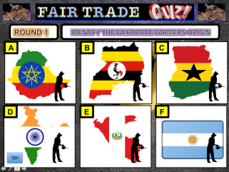


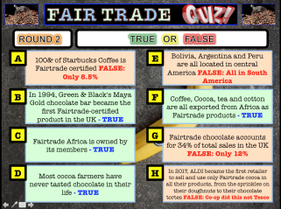

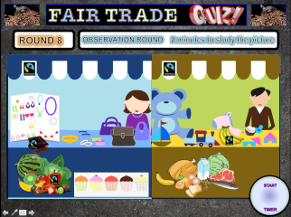
FAIR
TRADE
Over 60+ Questions
5 Hidden Video Clips
10 Different Rounds
Student Answer Sheets
FAIRTRADE
Notes:
Copyright Attributes:
TOP RIGHT - Free for commercial use No attribution required
BACKGROUND IMAGE - Free for commercial use No attribution required
https://commons.wikimedia.org/wiki/File:FairTrade-Logo.svg
A list of licenses for the images used in this presentation can be found here: https://creativecommons.org/licenses/

Slide 2





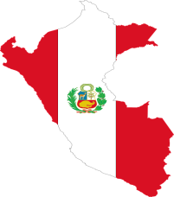

ROUND 1
IDENTIFY THE FAIR TRADE FARMERS ORIGIN
A
B
C
D
E
F
Notes:
Copyright Attributes:
TOP RIGHT - Free for commercial use No attribution required
BACKGROUND IMAGE - Free for commercial use No attribution required
A = https://pixabay.com/en/ethiopia-flag-map-geography-1758949/
B=https://pixabay.com/en/uganda-flag-map-geography-outline-1758988/
C= https://pixabay.com/en/ghana-flag-map-geography-outline-1758953/
D=https://pixabay.com/en/argentina-banner-decoration-flag-2025446/
E= https://pixabay.com/en/silhouette-agriculture-isolated-boy-3080760/
F= https://pixabay.com/en/the-hunger-games-woman-sexy-1150490/
A list of licenses for the images used in this presentation can be found here: https://creativecommons.org/licenses/

Slide 3
ROUND 2
TRUE OR FALSE
A
100% of Starbucks coffee is Fair Trade certified
E
Bolivia, Argentina and Peru are all located in central America
B
In 1994, Green & Black's Maya Gold chocolate bar became the first Fair Trade certified product in the UK
F
Coffee, cocoa, tea and cotton are all exported from Africa as Fair Trade products
C
Fair Trade Africa is owned by its members
G
Fair Trade chocolate accounts for 34% of total sales in the UK
D
Most cocoa farmers have never tasted chocolate in their life
H
In 2017, ALDI became the first retailer to use only Fairtrade cocoa in all their products (from doughnut sprinkles to chocolate tortes)
Notes:
Copyright Attributes:
TOP RIGHT - Free for commercial use No attribution required
BACKGROUND IMAGE - Free for commercial use No attribution required
A list of licenses for the images used in this presentation can be found here: https://creativecommons.org/licenses/

Slide 4
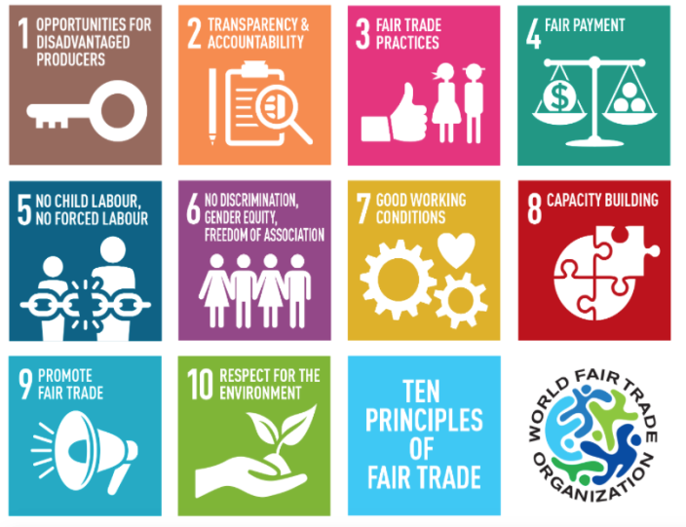



ROUND 3
FAIR TRADE PRINCIPLES MATCH THEM UP
Provide Opportunities
Respect for Environment
Capacity Building
Transparency and Accountability
Promote Fair Trade
Fair Payment
No Forced Labour or Child Labour
Anti-Discrimination & Gender Equality
Good Working Conditions
Fair Trade Practices
Notes:
Copyright Attributes:
TOP RIGHT - Free for commercial use No attribution required
BACKGROUND IMAGE - Free for commercial use No attribution required
A = All sourced under CCO licence no need for atribution
Image Reference CCO Fair use https://wfto.com/fair-trade/10-principles-fair-trade
A list of licenses for the images used in this presentation can be found here: https://creativecommons.org/licenses/

Slide 5
ROUND 4
MATCH THE COUNTRY TO THE LOCATION
A
Australasia
1
Sri Lanka
B
Asia
2
Papua New Guinea
C
Africa
3
Costa Rica
D
Central America
4
Tanzania
Notes:
Copyright Attributes:
TOP RIGHT - Free for commercial use No attribution required
BACKGROUND IMAGE - Free for commercial use No attribution required
A list of licenses for the images used in this presentation can be found here: https://creativecommons.org/licenses/

Slide 6
ROUND 5
NUMBERS ROUND
How many farmers and workers are there in Fair Trade certified
producer organisations?
A
1.1 million
1.66 Million
1.99 Million
3.1 Million
What % of all farmers and workers are women?
B
13%
23%
35%
53%
How many countries around the world have
Fair Trade certified producer organisations?
C
12
35
43
73
How much was paid in Fair Trade premiums was paid to
producers in 2016?
D
58 Million
100 Million
158 Million
1 billion
Notes:
Copyright Attributes:
TOP RIGHT - Free for commercial use No attribution required
BACKGROUND IMAGE - Free for commercial use No attribution required
A list of licenses for the images used in this presentation can be found here: https://creativecommons.org/licenses/

Slide 7
ROUND 6
ANAGRAMS –UNSCRAMBLE THE WORDS
Clue: South American Fair Trade Producing Countries
A
CLAIM BOO
B
RE UP
C
VIAL OBI
D
ANGER ANTI
Notes:
Copyright Attributes:
TOP RIGHT - Free for commercial use No attribution required
BACKGROUND IMAGE - Free for commercial use No attribution required
A list of licenses for the images used in this presentation can be found here: https://creativecommons.org/licenses/

Slide 8
ROUND 7
MULTIPLE CHOICE – GUESS CORRECT
How many local Fair Trade campaigning groups
exist in the UK?
A
5,000
10,000
50,000
100,000
What % of UK customers recognise the
Fair Trade logo when shown it?
B
47%
78%
93%
100%
Which of these brings in the most funding
for the Fair Trade Foundation?
C
Licence fee from Fairtrade certified products
Grants and Donations
Other Income
Sponsorship
D
Which of these is NOT a type of wild banana?
Gold Tiger
Bubblegum Pink
Green and White
Musa Nendran
Notes:
Copyright Attributes:
TOP RIGHT - Free for commercial use No attribution required
BACKGROUND IMAGE - Free for commercial use No attribution required
A list of licenses for the images used in this presentation can be found here: https://creativecommons.org/licenses/

Slide 9











ROUND 8
OBSERVATION ROUND 2 minutes to study the picture
TIME’S UP
1 Minute!
2 Minutes
START
TIMER
Notes:
Images
Copyright Attributes:
TOP RIGHT - Free for commercial use No attribution required
BACKGROUND IMAGE - Free for commercial use No attribution required
https://pixabay.com/en/market-mercao-fair-souk-bazaar-2071976/
https://pixabay.com/en/market-toys-fair-souk-bazaar-shop-2071975/
https://pixabay.com/en/fruits-vegetables-artichoke-banana-155616/
https://pixabay.com/en/valentine-clip-art-valentine-banner-3868482/

Slide 10
ROUND 8
OBSERVATION ROUND
A
How many Fair Trade items were being sold?
E
Was there a coconut being sold?
B
Was the Milk Fair Trade?
F
How many pairs of earrings were being sold?
C
How many carriages did the train have?
G
What colour eyes did the man have?
D
What color pearls was the lady wearing?
H
How many cupcakes are being sold?
Notes:
Copyright Attributes:
TOP RIGHT - Free for commercial use No attribution required
BACKGROUND IMAGE - Free for commercial use No attribution required

Slide 11
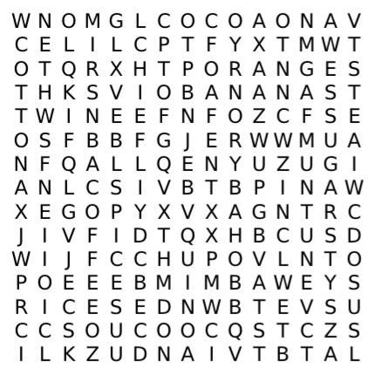



ROUND 9
WORDSEARCH – FIND THE WORDS
YOU HAVE FIVE MINUTES TO:
FIND ALL 15 Fair Trade Items hidden in the wordsearch
TIME’S UP
1 Minute!
2 Minutes
3 Minutes
4 Minutes
5 Minutes
START
TIMER
Notes:
Copyright Attributes:
TOP RIGHT - Free for commercial use No attribution required
BACKGROUND IMAGE - Free for commercial use No attribution required
A list of licenses for the images used in this presentation can be found here: https://creativecommons.org/licenses/

Slide 12
ROUND 10
MATCH THE FAIRTRADE BRAND TO THE PRODUCT
A
T2
1
Ice Cream
B
Divine
2
Tea
C
Lucy Bee
3
Dark Chocolate
D
Ben & Jerry’s
4
Coconut Oil
Notes:
Copyright Attributes:
TOP RIGHT - Free for commercial use No attribution required
BACKGROUND IMAGE - Free for commercial use No attribution required
A list of licenses for the images used in this presentation can be found here: https://creativecommons.org/licenses/

Slide 13


TIE BREAK
DESIGN IT – CREATE THE FOLLOWING
Design a placard to encourage customers to buy Fairtrade products
In the event of a tie break or even a close finish points can be awarded to the top three designs
GOLD = 5 POINTS
SILVER = 3 POINTS
BRONZE = 1 POINT
Notes:
Copyright Attributes:
TOP RIGHT - Free for commercial use No attribution required
BACKGROUND IMAGE - Free for commercial use No attribution required
MEDALS - Free for commercial use No attribution required
https://pixabay.com/en/greeting-card-background-2245717/
A list of licenses for the images used in this presentation can be found here: https://creativecommons.org/licenses/

Slide 14



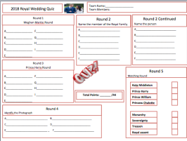

FAIR
TRADE
Notes:
Copyright Attributes:
TOP RIGHT - Free for commercial use No attribution required
BACKGROUND IMAGE - Free for commercial use No attribution required
MID LEFT - Dirk Ercken
LOWER LEFT - Iqoncept
LOWER RIGHT - Free for commercial use No attribution required
A list of licenses for the images used in this presentation can be found here: https://creativecommons.org/licenses/

Slide 15
ROUND 1
IDENTIFY THE FAIRTRADE FARMERS ORIGIN
A
B
C
UGANDA
ETHIOPIA
GHANA
D
E
F
PERU
ARGENTINA
INDIA.
Notes:
Copyright Attributes:
TOP RIGHT - Free for commercial use No attribution required
BACKGROUND IMAGE - Free for commercial use No attribution required
A = https://pixabay.com/en/ethiopia-flag-map-geography-1758949/
B=https://pixabay.com/en/uganda-flag-map-geography-outline-1758988/
C= https://pixabay.com/en/ghana-flag-map-geography-outline-1758953/
D=https://pixabay.com/en/argentina-banner-decoration-flag-2025446/
E= https://pixabay.com/en/silhouette-agriculture-isolated-boy-3080760/
F= https://pixabay.com/en/the-hunger-games-woman-sexy-1150490/
A list of licenses for the images used in this presentation can be found here: https://creativecommons.org/licenses/

Slide 16
TRUE OR FALSE
ROUND 2
TRUE OR FALSE
ROUND 2
A
A
100% of Starbucks coffee is Fair Trade certified
E
E
Bolivia, Argentina and Peru are all located in central America
Only 8.5%
All in South America
B
B
In 1994, Green & Black's Maya Gold chocolate bar became the first Fair Trade certified product in the UK
F
F
Coffee, cocoa, tea and cotton are all exported from Africa as Fair Trade products
C
C
Fair Trade Africa is owned by its members
G
G
Fair Trade chocolate accounts for 34% of total sales in the UK
Only 12%
D
D
Most cocoa farmers have never tasted chocolate in their life
H
H
In 2017, ALDI became the first retailer to use only Fairtrade cocoa in all their products (from doughnut sprinkles to chocolate tortes)
Co-op did this not ALDI
Notes:
Copyright Attributes:
TOP RIGHT - Free for commercial use No attribution required
BACKGROUND IMAGE - Free for commercial use No attribution required
A list of licenses for the images used in this presentation can be found here: https://creativecommons.org/licenses/

Slide 17
ROUND 3
FAIR TRADE PRINCIPLES MATCH THEM UP
Provide Opportunities
Respect for Environment
Provide Opportunities
Transparency and Accountability
Fair Trade Practices
Fair Payment
Capacity Building
Transparency and Accountability
Promote Fair Trade
No Forced Labour or Child Labour
Anti -Discrimination & Gender Equality
Good Working Conditions
Capacity Building
Fair Payment
No Forced Labour or Child Labour
Anti-Discrimination & Gender Equality
Good Working Conditions
Promote Fair Trade
Respect for Environment
Fair Trade Practices
Notes:
Copyright Attributes:
TOP RIGHT - Free for commercial use No attribution required
BACKGROUND IMAGE - Free for commercial use No attribution required
A = All sourced under CCO licence no need for atribution
Image Reference CCO Fair use https://wfto.com/fair-trade/10-principles-fair-trade
A list of licenses for the images used in this presentation can be found here: https://creativecommons.org/licenses/

Slide 18
ROUND 4
MATCH THE COUNTRY TO THE LOCATION
A
Australasia
1
Sri Lanka
B
Asia
2
Papua New Guinea
C
Africa
3
Costa Rica
D
Central America
4
Tanzania
Notes:
Copyright Attributes:
TOP RIGHT - Free for commercial use No attribution required
BACKGROUND IMAGE - Free for commercial use No attribution required
A list of licenses for the images used in this presentation can be found here: https://creativecommons.org/licenses/

Slide 19
ROUND 5
NUMBERS ROUND
How many farmers and workers are there in Fair Trade certified
producer organisations?
A
1.1 million
1.66 Million
1.99 Million
3.1 Million
What % of all farmers and workers are women?
B
13%
23%
35%
53%
How many countries around the world have
Fair Trade certified producer organisations?
C
12
35
43
73
How much was paid in Fair Trade premiums was paid to
producers in 2016?
D
58 Million
100 Million
158 Million
1 billion
Notes:
Copyright Attributes:
TOP RIGHT - Free for commercial use No attribution required
BACKGROUND IMAGE - Free for commercial use No attribution required
A list of licenses for the images used in this presentation can be found here: https://creativecommons.org/licenses/

Slide 20
ROUND 6
ANAGRAMS –UNSCRAMBLE THE WORDS
Clue: South American Fair Trade Producing Countries
A
CLAIM BOO
COLOMBIA
B
PERU
RE UP
C
VIAL OBI
BOLIVIA
D
ARGENTINA
ANGER ANTI
Notes:
Copyright Attributes:
TOP RIGHT - Free for commercial use No attribution required
BACKGROUND IMAGE - Free for commercial use No attribution required
A list of licenses for the images used in this presentation can be found here: https://creativecommons.org/licenses/

Slide 21
ROUND 7
MULTIPLE CHOICE – GUESS CORRECT
How many local Fair Trade campaigning groups
exist in the UK?
A
5,000
10,000
50,000
100,000
What % of UK customers recognise the
Fair Trade logo when shown it?
B
47%
78%
93%
100%
Which of these brings in the most funding
for the Fair Trade Foundation?
C
Licence fee from Fairtrade certified products
Grants and Donations
Other Income
Sponsorship
D
Which of these is NOT a type of wild banana?
Gold Tiger
Bubblegum Pink
Green and White
Musa Nendran
Notes:
Copyright Attributes:
TOP RIGHT - Free for commercial use No attribution required
BACKGROUND IMAGE - Free for commercial use No attribution required
A list of licenses for the images used in this presentation can be found here: https://creativecommons.org/licenses/

Slide 22
ROUND 8
OBSERVATION ROUND
A
How many Fair Trade items were being sold?
E
Was there a coconut being sold?
Three
Yes
B
Was the Milk Fair Trade?
F
How many pairs of earrings were being sold?
No
Ten
C
How many carriages did the train have?
G
What colour eyes did the man have?
One
He didn’t have eyes!
D
What color pearls was the lady wearing?
H
How many cupcakes are being sold?
Light blue
Five
Notes:
Copyright Attributes:
TOP RIGHT - Free for commercial use No attribution required
BACKGROUND IMAGE - Free for commercial use No attribution required

Slide 23
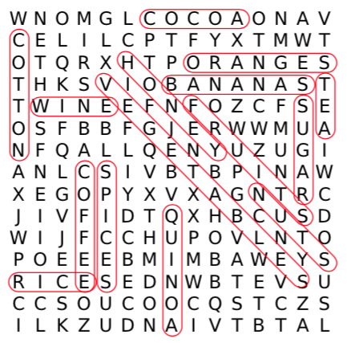
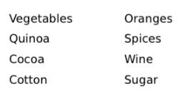
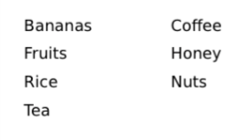
ROUND 9
WORDSEARCH – FIND THE WORDS
YOU HAVE FIVE MINUTES TO:
FIND ALL 15 Fair Trade Items hidden in the wordsearch
Notes:
Copyright Attributes:
TOP RIGHT - Free for commercial use No attribution required
BACKGROUND IMAGE - Free for commercial use No attribution required
A list of licenses for the images used in this presentation can be found here: https://creativecommons.org/licenses/

Slide 24
ROUND 10
MATCH THE FAIR TRADE BRAND TO THE PRODUCT
A
T2
1
Ice Cream
B
Divine
2
Tea
C
Lucy Bee
3
Dark Chocolate
D
Ben & Jerry’s
4
Coconut Oil
Notes:
Copyright Attributes:
TOP RIGHT - Free for commercial use No attribution required
BACKGROUND IMAGE - Free for commercial use No attribution required
A list of licenses for the images used in this presentation can be found here: https://creativecommons.org/licenses/

Slide 25
TIE BREAK
DESIGN IT – CREATE THE FOLLOWING
Design a placard to encourage customers to buy Fairtrade products
In the event of a tie break or even a close finish points can be awarded to the top three designs
GOLD = 5 POINTS
SILVER = 3 POINTS
BRONZE = 1 POINT
Notes:
Copyright Attributes:
TOP RIGHT - Free for commercial use No attribution required
BACKGROUND IMAGE - Free for commercial use No attribution required
MEDALS - Free for commercial use No attribution required
https://pixabay.com/en/greeting-card-background-2245717/
A list of licenses for the images used in this presentation can be found here: https://creativecommons.org/licenses/

Slide 26

FAIR
TRADE
THANK YOU FOR PLAYING
FOR MORE RESOURCES
CLICK HERE
Notes:
Copyright Attributes:
BACKGROUND IMAGE - GraysonArthur2017
TOP RIGHT - Free for commercial use No attribution required
A list of licenses for the images used in this presentation can be found here: https://creativecommons.org/licenses/

Slide 27
Copyright Attribution
All content and images used within this product have been developed by the creator of this product or sourced under license
Any content or images under license have been attributed and can be found on the notes of each slide
We carefully go through images, pay for them if required or select ones with appropriate licenses.
We believe in copyright protection, proper use and attribution of our content and images, however if there are any issues please don’t hesitate to contact us info@cre8tiveresources.co.uk
For Information on licenses used:
https://creativecommons.org/licenses/

Slide 28


FAIR TRADE
Team Name:__________________
Team Members:
Round 1
Fair Trade Farmers
A___________________ D___________________
B___________________ E____________________
C___________________ F____________________
Round 4
Fair Trade Countries
Round 5
Numbers Round
A_______________________________
B_______________________________
C_______________________________
D_______________________________
Australasia
Asia
Africa
Central America
Round 2
True or False
A____________________ E____________________
B____________________ F____________________
C____________________ G____________________
D____________________ H____________________
Round 6
Anagrams Round
A_______________________________
B_______________________________
C_______________________________
D_______________________________
Total Points: _______ /36
Round 3
Fair Trade Principles
A__________________________ D___________________________
B__________________________ E___________________________
C__________________________ F___________________________
Round 7
Multiple Choice Round
A__________________________________________________
B__________________________________________________
C__________________________________________________
D__________________________________________________

Slide 29

FAIR TRADE
Team Name:__________________
Team Members:
Round 8
Observation Round
A____________________ E____________________
B____________________ F____________________
C____________________ G____________________
D____________________ H____________________
Round 9
Fairtrade Certified Products
1____________________ 6____________________ 11____________________ 2____________________ 7____________________ 12____________________
3____________________ 8____________________ 13____________________ 4____________________ 9____________________ 14____________________
5____________________ 10___________________ 15____________________
Tie Breaker – Design Challenge
Round 10
Well known Fair Trade brands
T2
Divine
Lucy Bee
Ben & Jerry’s
Total Points: _______/36
Total Points: _______/27
Total Points: _______/63

