Slide 1
Fairtrade Fortnight
26th February – 11th March 2021

Slide 2
Did you guess this one correct?
A Fairtrade chocolate bar.
Name the chocolate bar…
Yorkie
Divine
Toblerone
Twirl
Double Decker
Aero
Flake
Dairy Milk
Galaxy
Milky Bar

Slide 3
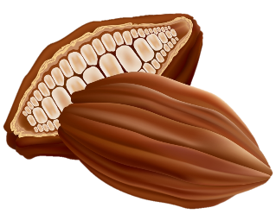
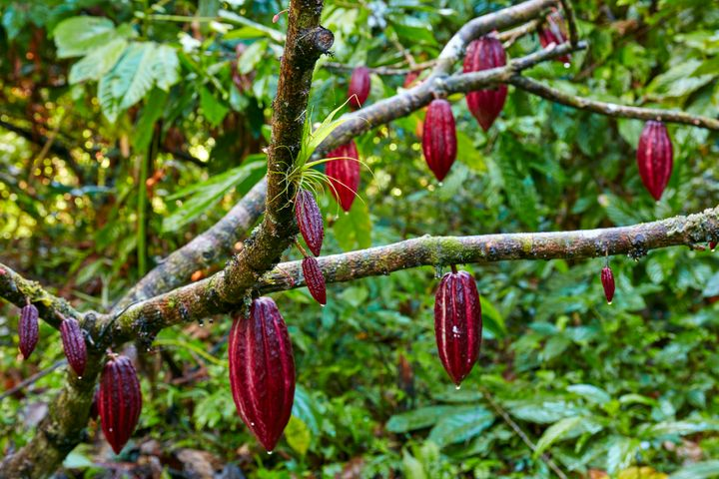
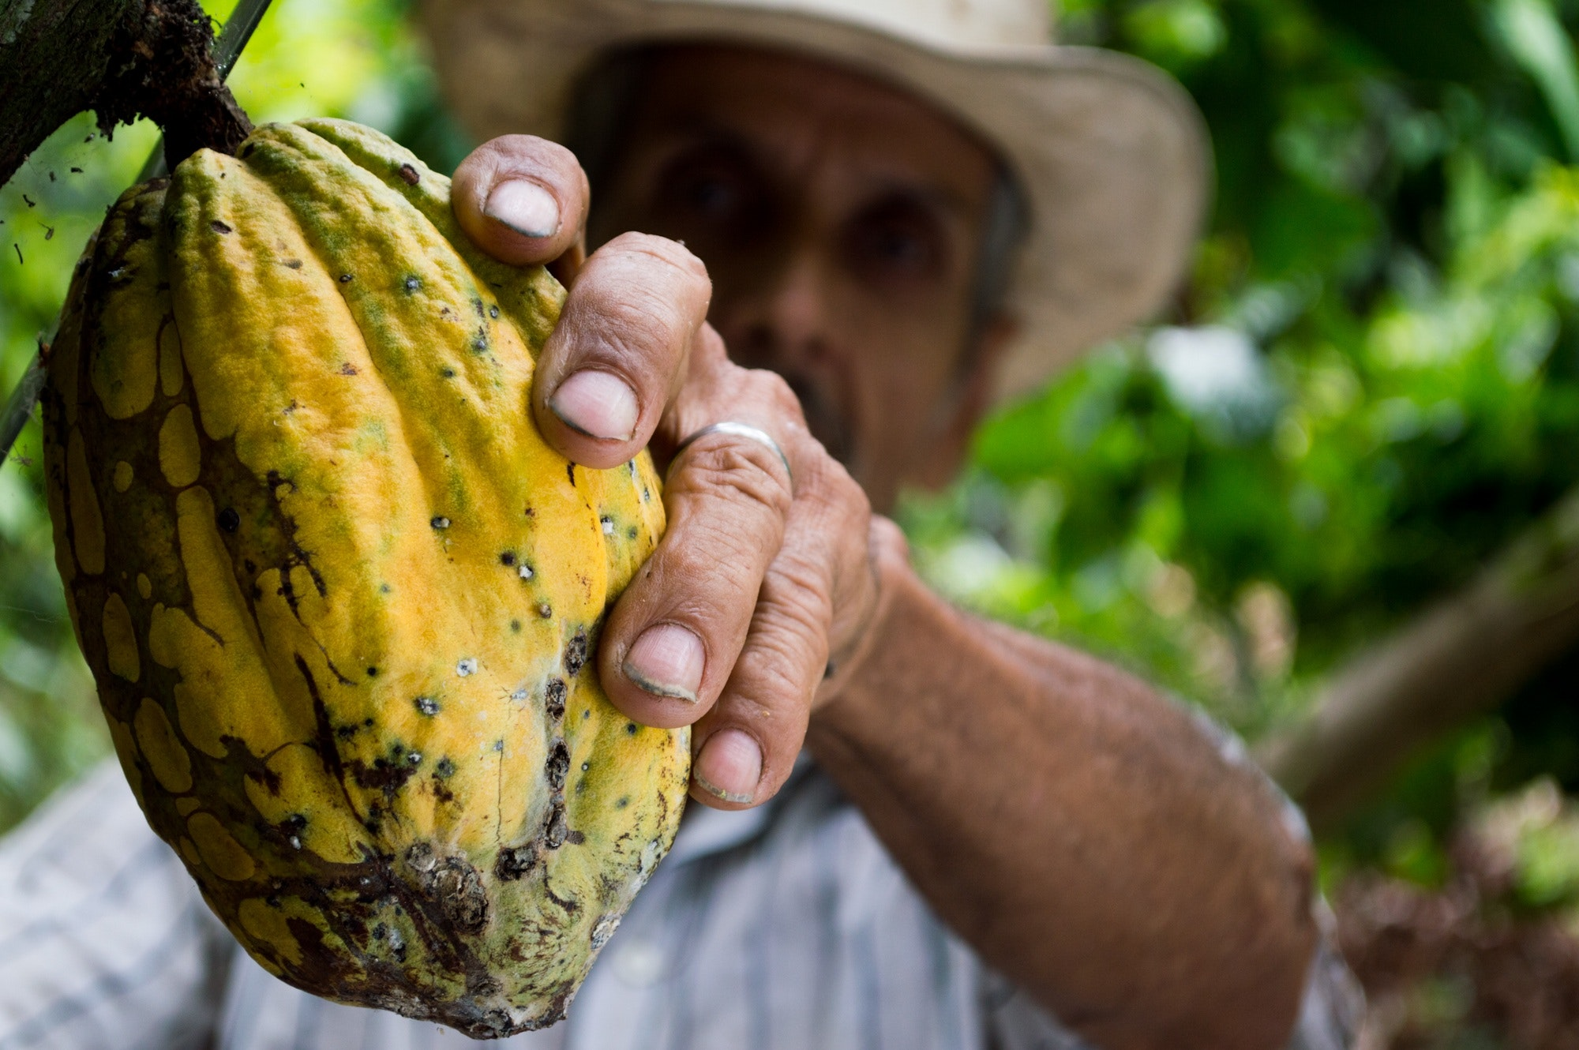
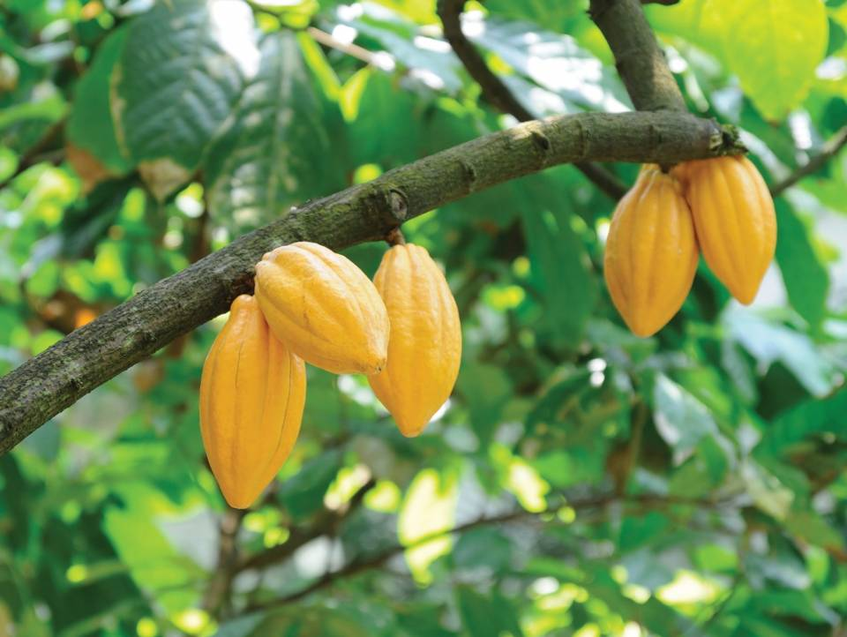
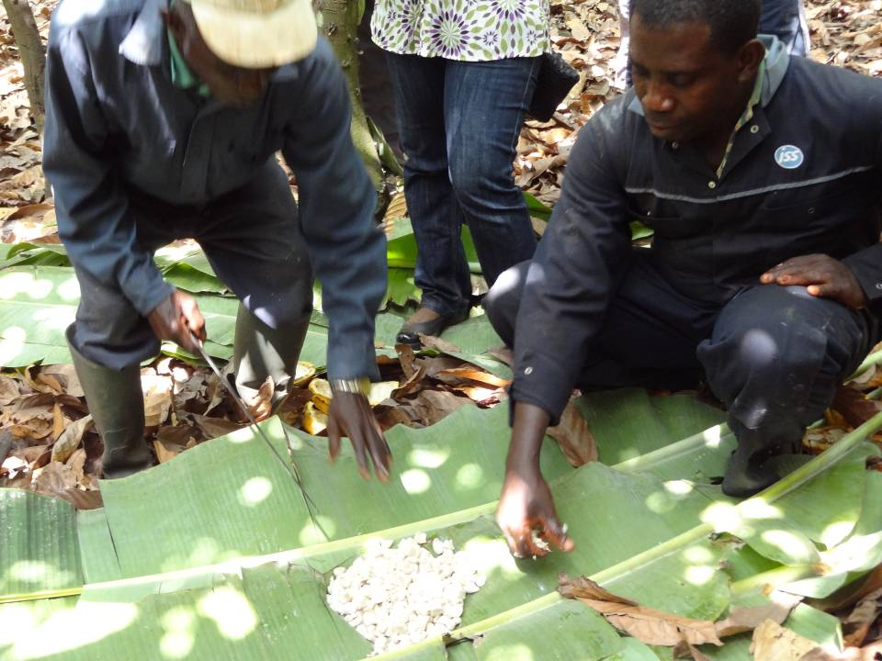
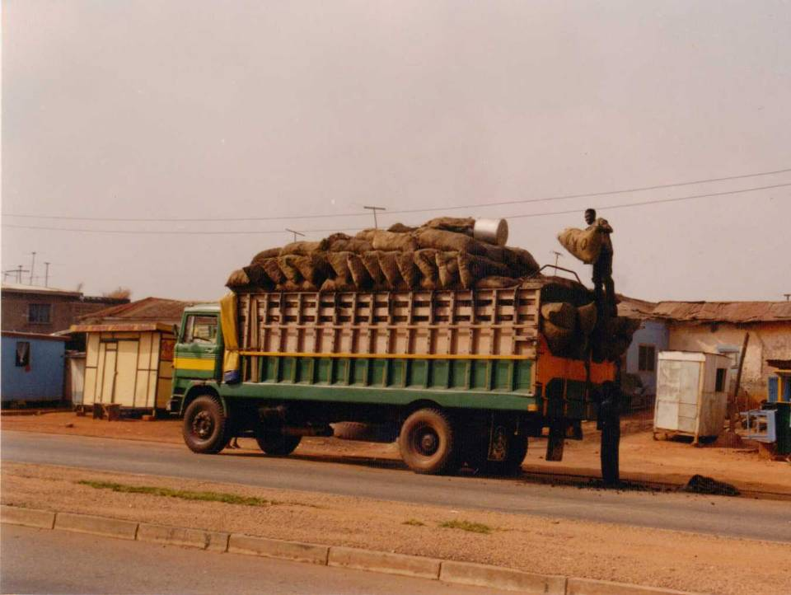
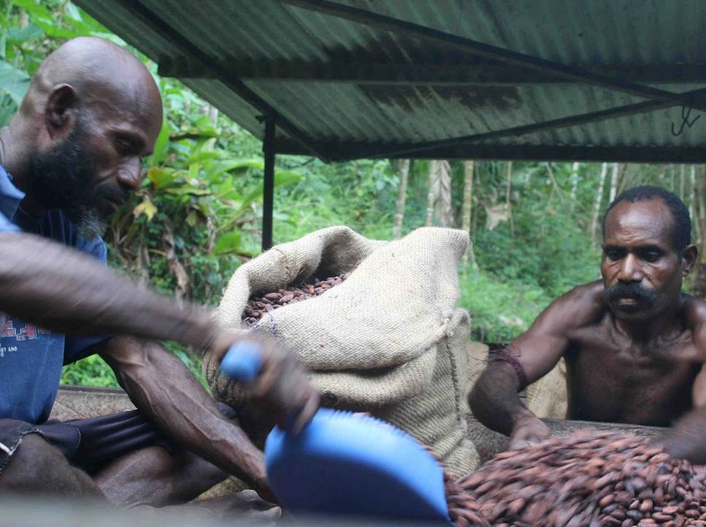
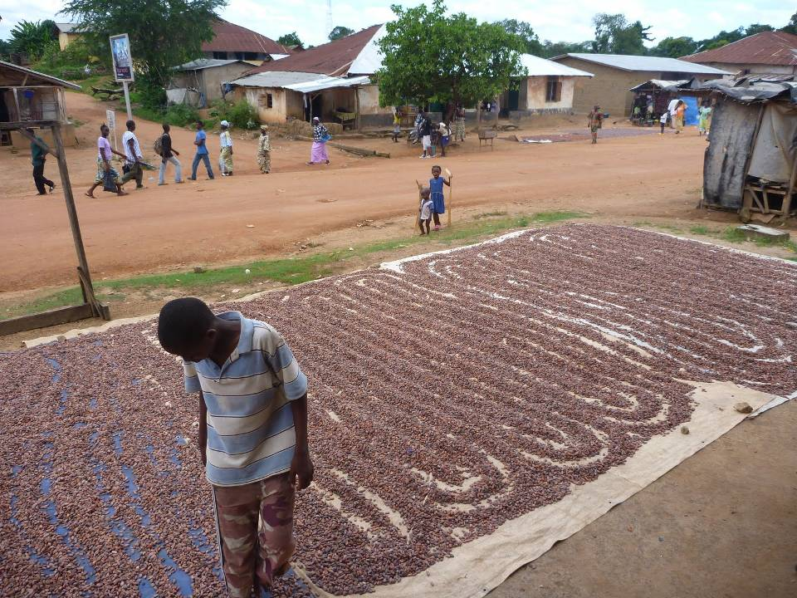
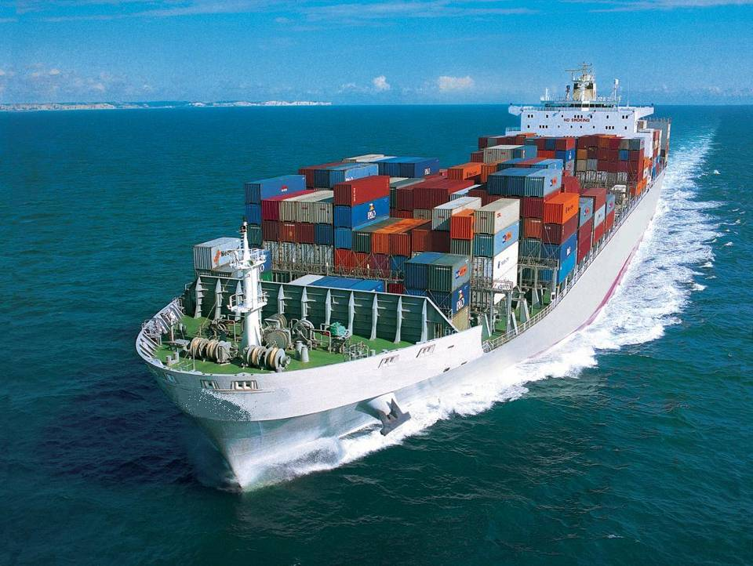
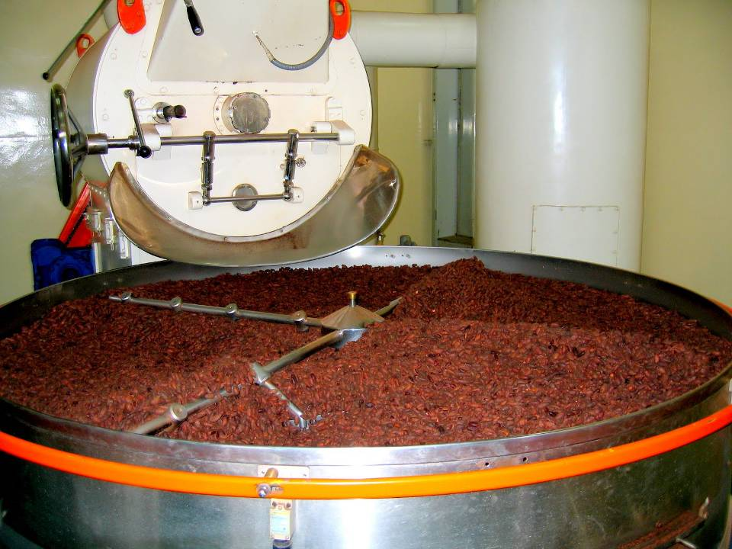
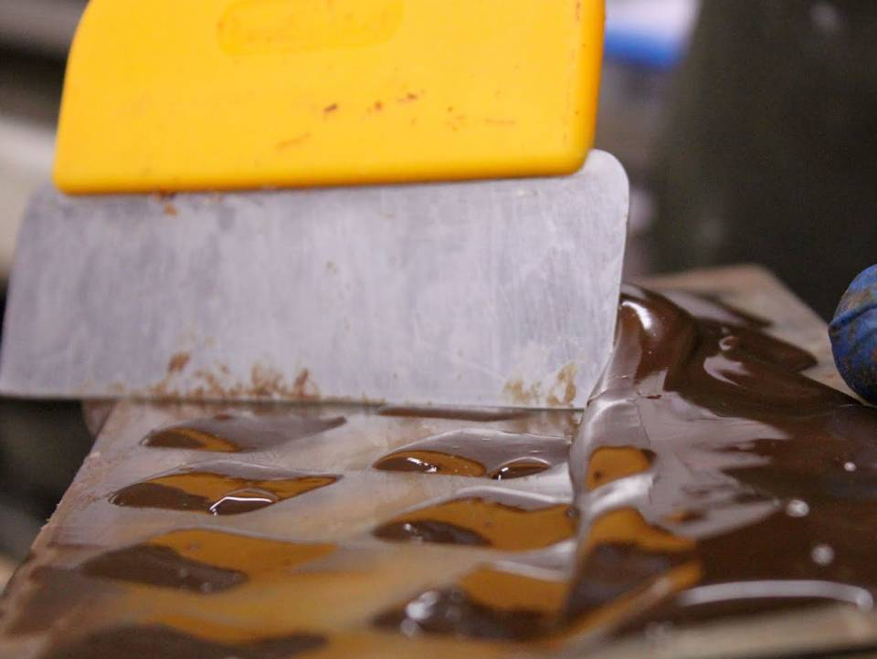
From Bean to Bar…
Cocoa pods grow and ripen
Harvesting
Fermentation
Transport
Packing and weighing
Drying
Shipping
Winnowing
Moulding and packaging

Slide 4
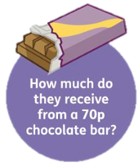
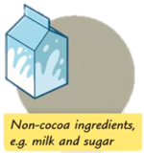
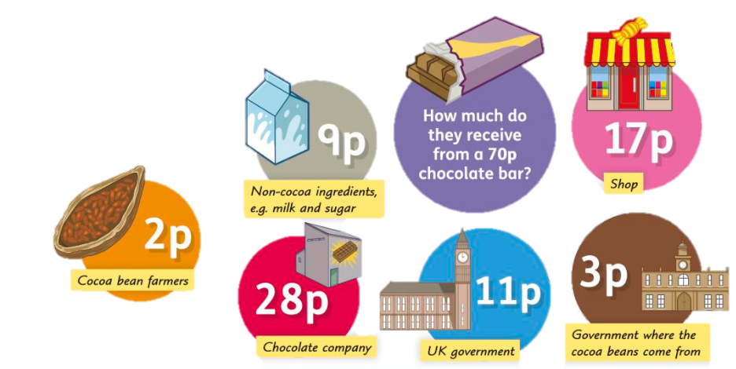
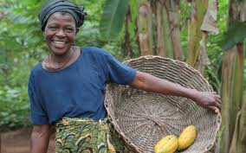
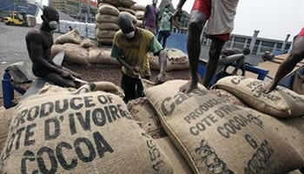
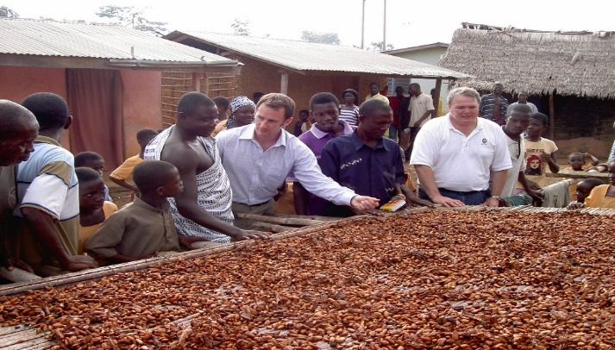
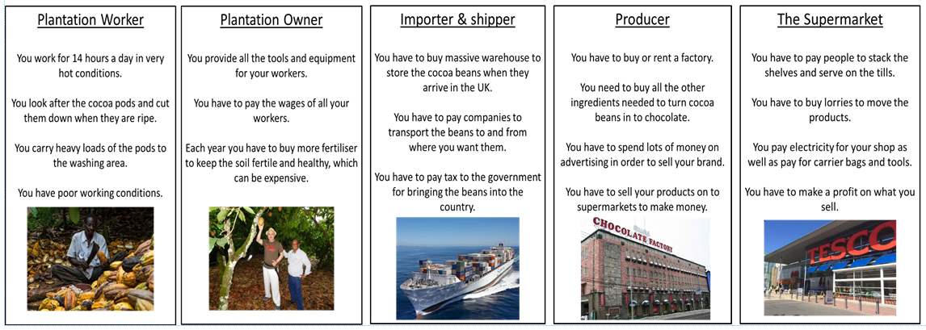
Farmer:
• Grow and care for the cocoa trees for three to five years.
• Harvest the cocoa pods in very hot temperatures.
• Remove the beans from the pods.
• Ferment the beans for six days and dry them for ten days.
• Take the sacks of beans to sell to cocoa buyers.
c) Do you think the farmer gets a fair price?
b) Calculate the percentage that the chocolate company gets.
2. a) Calculate the amount of money a cocoa bean farmer gets as a percentage of the price of a bar of chocolate?
Money earnt:
Shops:
• Buy the chocolate bars from the chocolate companies.
• Sell the chocolate bars to shoppers.
Importers
• Arranges transport for the beans to the UK.
• Turn the beans into cocoa solids and cocoa butter.
Money earnt:
Government:
• Money received from foreign buyers.
Money earnt:
Chocolate companies:
• Buy the cocoa solids and cocoa butter.
• Buy the other ingredients.
• Make the chocolate bars.
• Pay for the chocolate bar wrappers.
• Pay for advertising the chocolate bars.
Money earnt:
UK Government:
• Charges tax on the chocolate bars.
Money earnt:
Money earnt:

Slide 5
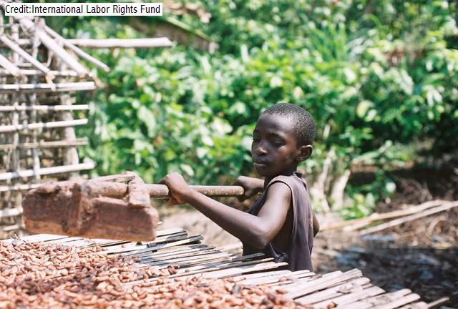
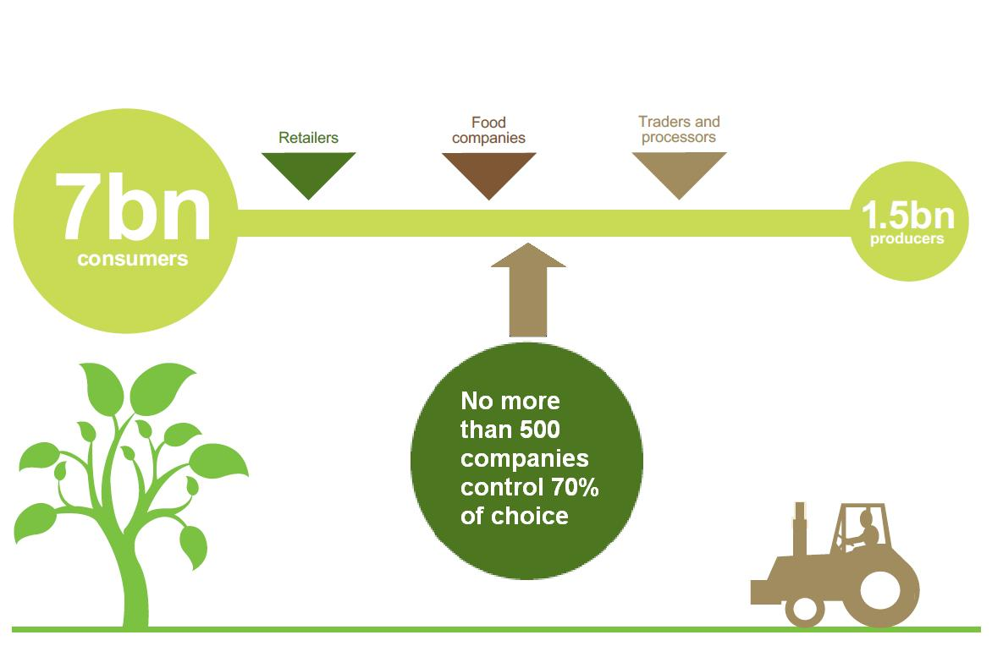
What is Unfair Trade?
Click to watch
the clip
• Poor living conditions.
• Child or forced labour.
• Poor working conditions.
• Low wage, not enough to
cover the cost of production.
• Increased poverty for
producers in LICs.
• Negative impact on the
environment.
Would you feel comfortable buying chocolate, sugar etc if you knew the farmers who grew it did not get a fair price for their labour and were struggling even to eat?
How can this problem be solved?

Slide 6
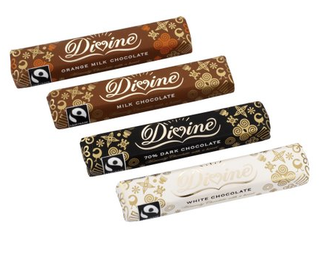
Fairtrade
Fairtrade ensures:
Fair terms of trade for farmers and workers in the developing world.
Guarantees a fair price for small producers (regardless of world market).
Better prices - Fairtrade cuts out the middleman meaning more profit goes to the farmer.
Decent working conditions - 48 hour working week maximum, minimum wage, health & safety etc.
Restrictions on child labour - no workers under the age of 15.
Promotes local sustainability – as farmers are paid fairly, they don’t need to use harmful chemicals to grow more food, faster.
Fairtrade products are usually more expensive than non-Fairtrade.
There are 6,000 products in the UK certified as Fairtrade.

Slide 7
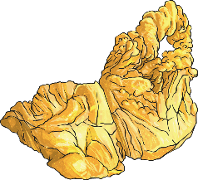
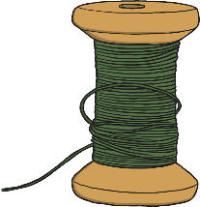
Fairtrade Produce
bananas
chocolate
gold
coffee
cotton
flowers
sugar
tea

Slide 8
Who Does Fairtrade Help?
1.4 million small scale farmers and workers in 1,140 producer organisations.
Farmers and workers in 74 different countries.
What type of produce might be Fairtrade?

Slide 9
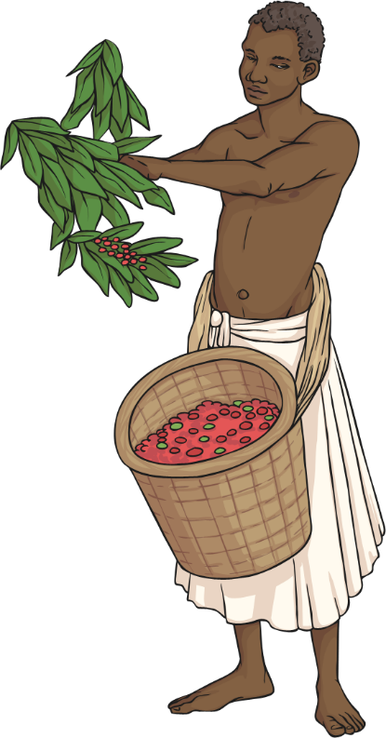
What Is Fairtrade Fortnight?
Fairtrade Fortnight is an annual promotional campaign organised and funded by the Fairtrade Foundation to increase awareness of Fairtrade products.

Slide 10
What Does the Fairtrade Sign Mean?
Fairtrade is 50% owned by producers
Fairtrade works with a range of stakeholders but the global system is 50% owned by producers representing farmer and worker organisations. With an equal voice, producers have a say in decision-making.
Fairtrade Minimum Price
For most Fairtrade goods there is a Fairtrade Minimum Price which is set to cover the cost of sustainable production for that product in that region.
Fairtrade Premium
The Fairtrade Premium is an additional sum of money which goes into a communal fund for workers and farmers to use to improve their social, economic and environmental conditions.

Slide 11
My name is Isaac, I am twelve years old, I live in Ghana with my family in a small hut. There are eight of us altogether, so it is a bit crowded in our home. Our family is very poor and so we all have to help to earn money. We work on a cocoa plantation and it’s very hot and humid here. After a day’s work, I’m covered in insect bites. My job is to collect the cocoa pods. I then have to scoop the sticky pulp an beans from the pods with my hands. I heard that the beans are turned into something sweet called chocolate, which people eat. I often wonder what it tastes like. We can’t afford to buy it. My family can’t afford to send me to school either, so I can’t read or write. The pay is so bad that we often go hungry. We can’t even grow our own food because we don’t have any land.
My name is Lameck and I am twelve years old, I live in Ghana with my family. My parents work on a Cocoa plantation. Sometimes I help them but usually I’m at school. I’m learning to read and write. I want to work hard at school, so I can become a doctor. When I get some more money, I’m going to get a new t-shirt and jeans. We are lucky to have money. My dad says it’s because we joined the Kuapo Kakoo Cooperative. It sells cocoa beans for fair trade organisations. Many people in rich countries set up these organisations because they were worried that people were not being paid properly for the work they do. The fair trade organisations pay us more than other organisations do, £150 more for every tonne of beans.
Writing frame:
Dear Nestlé,
My name is …. and I am writing to you to ask you to use fair trade cocoa beans in all your chocolate. I am asking this because I have read about the story of Ricardo from Brazil. Ricardo……
Now write about Ricardo’s life – working conditions and his life.
Then write about Lameck and how his life is better. IN DETAIL.
Now discuss the chocolate tasking – Fair trade chocolate tastes pretty good!
I hope you take notice of this letter, many thanks for your time.
Yours Faithfully….

Slide 12
Is Fairtrade really fair?
• Producers get 50% of the money paid by consumers.
• Some farmers cannot afford the fees to join the Fairtrade network.
• Remote/poor farmers not able to get organised into co-operatives.
• Getting your product Fairtrade certified falls on the farmer – a lot of work for the poor.
• Fairtrade harms those farmers who are not part of the network.

Slide 13
What More Can We Do?
Hold a Fairtrade stall in school – it’s a good way to encourage parents and carers to find out more.
Try to spot as many different Fairtrade products as possible in the local supermarket.
Make some Fairtrade cakes or biscuits – you could sell them as a fundraising activity.
Research the possibility of using Fairtrade products in the school kitchen.
Explore the possibility of being a Fairtrade school. Think about ways the whole community can get involved and change to Fairtrade products.

Slide 14
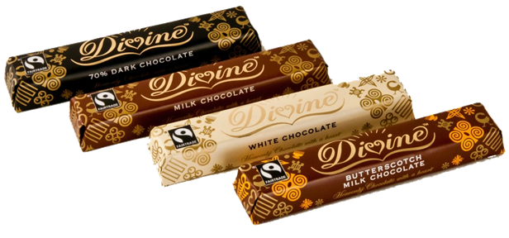
Reflection
Will you now buy Fairtrade products, knowing that your money will go towards ensuring a good quality of life for someone in a LIC?

