Slide 1




Children’s Mental Health Week Assembly KS3/4

Slide 2


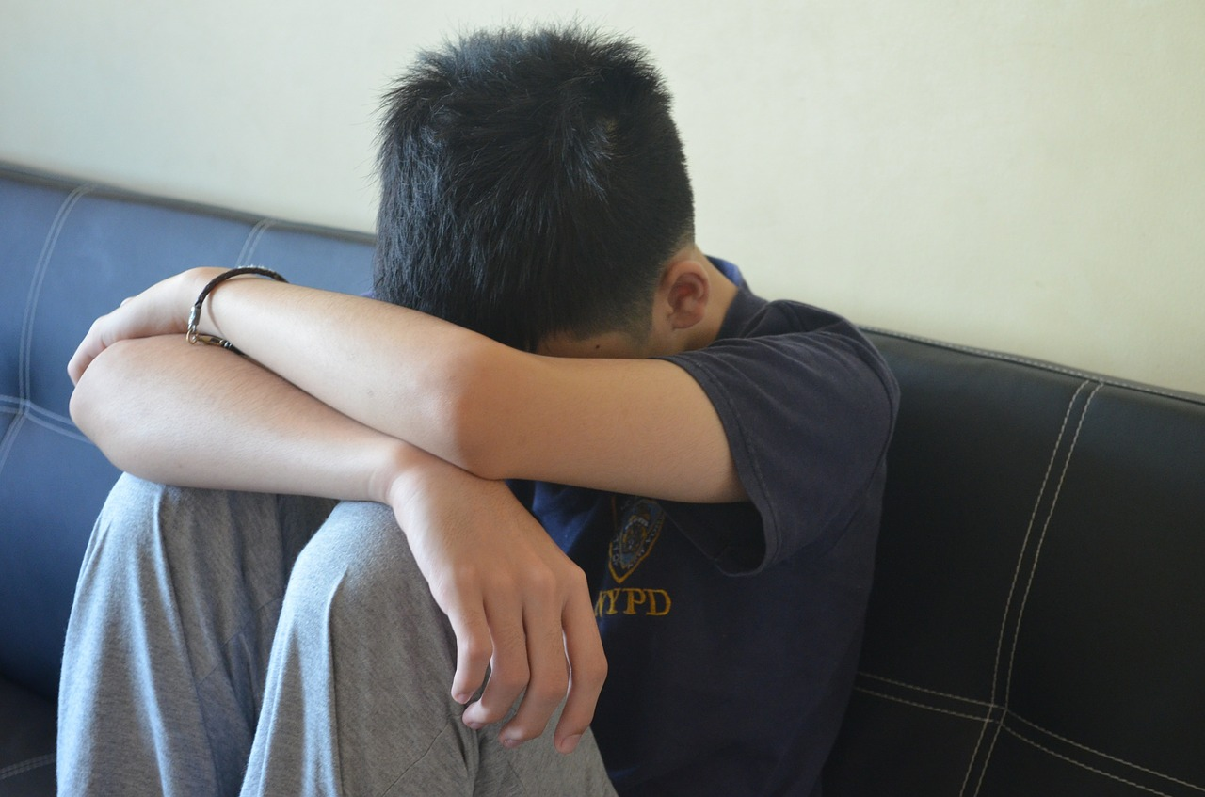
What do all these young people have in common?
I can’t believe how much work I have to do! I don’t get any
of this! I feel so overwhelmed!
My thoughts are so dark recently. I feel so, so sad.
I don’t want to see anyone today.
I can’t face that maths class. Sir might pick me to answer in front of everyone. I get everything wrong.

Slide 3
What do all these young people have in common?
STRESS
They are all currently suffering
from mental health issues.
DEPRESSION
ANXIETY

Slide 4
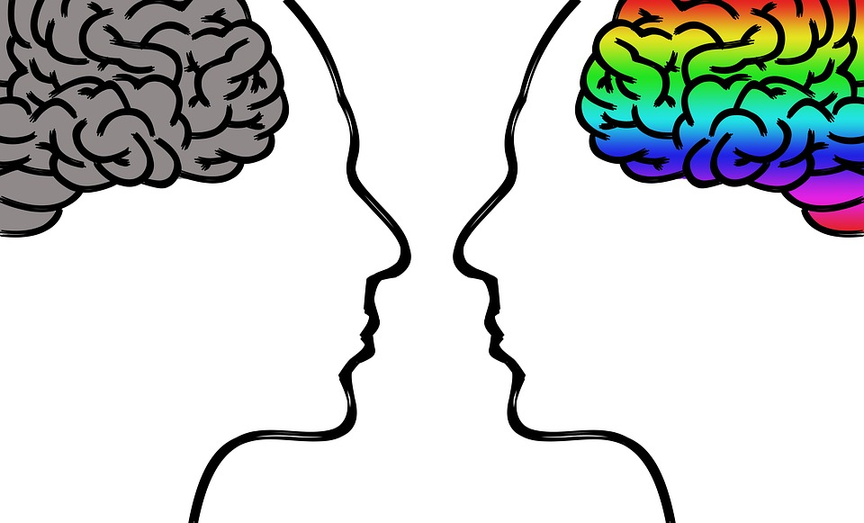
Eating disorders
Schizophrenia
Addiction
Bipolar Disorder
We all have a level of mental health, in the same way we do physical health. As any of us can become mentally ill.
You may have heard of the three examples of mental health issues I just presented you with, as these are the most common amongst young people. However, there are many more.

Slide 5





We have to ensure we look after our minds in the same way that we look after our bodies. Most of us already know how to look after our physical health.
Who can give me a couple of simple examples of how we look after our physical health?

Slide 6
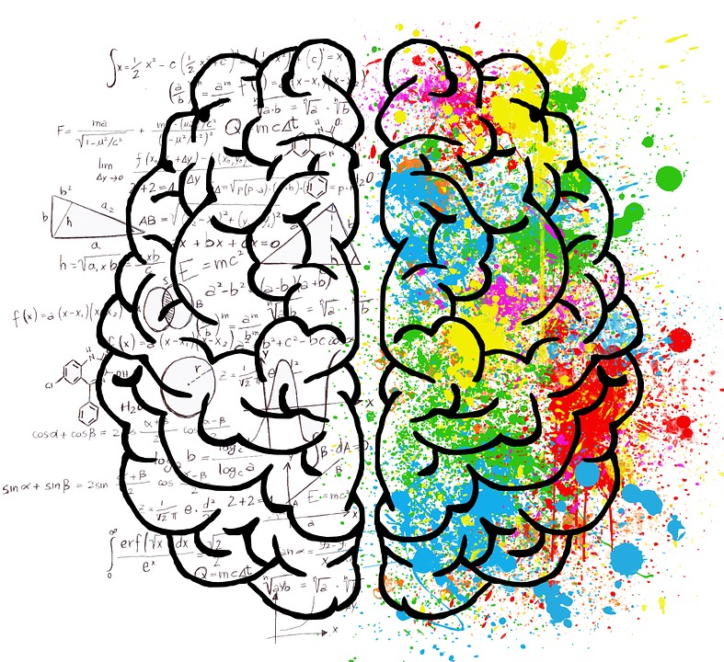

We have to ensure we look after our minds in the same way that we look after our bodies. How to look after your mental health, however, is far less obvious.
Who can give me a couple of simple examples of how we look after our mental health?
https://www.youtube.com/watch?v=1pNcH8zj8zo
It’s all the same things!

Slide 7
So if these depression, anxiety and stress sufferers do all those things, they’ll be cured?
No. They may start to feel better though.
This is because many of the things which cause us to have mental health issues are real life situations which have to be tackled.
Exercising may help you feel better while you study, but it won’t make your exams go away.
If you live healthily whilst you study however, you will be able to study more effectively – so you will have less to stress about.

Slide 8

What if my mental health issues AREN’T caused by life issues?
This is a different matter. You brain is a powerful and complicated thing.
Just like a well-kept car that needs oil, water and petrol in varying amounts, your brain needs certain chemicals to keep it ticking over and keep you feeling as you are supposed to.
When these chemicals are out of
balance, it causes mental health issues.
This is when you may need a doctor too.

Slide 9
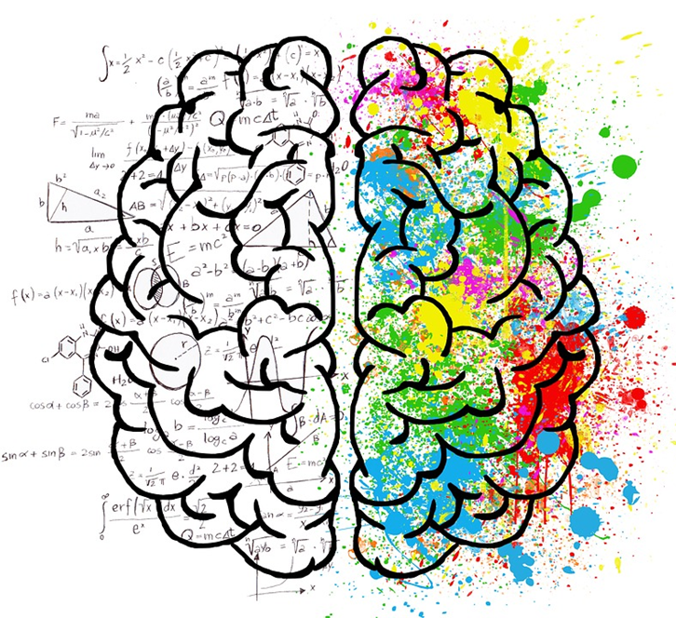

So what do I really need to remember about all this?
1. Mental health is as important as physical
health and we must take steps to care for both.
2. Mental health issues are VERY common and are
usually caused by life events. Telling people we trust how we feel can help. Your teachers can tell you where to get confidential and professional advice.
3. We all feel bad for no real reason sometimes, but if you take the healthy steps advice and there is no improvement and how you feel is nothing to do with life events, tell your parents, guardians or an adult you trust immediately.

