Slide 1

National Story Telling Week
30th January – 6th February

Slide 2
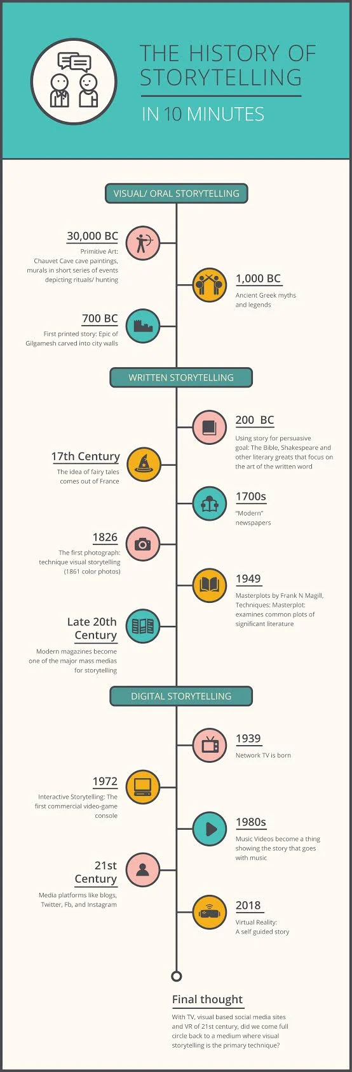
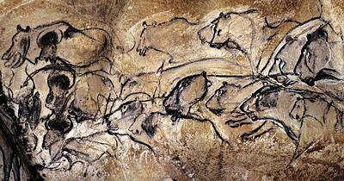
Story Telling:
Story telling is something that we as humans have done for many years. This can go all the way back to 30,000 BC to the cave men. Paintings on the walls of caves have been found in Southern France, which have been preserved over time. The cave drawings told stories about encountering mammoths, lions and rhinos. The paintings depicted their every day activities of using homemade weapons and using every piece of inch of an animal to survive.

Slide 3

The Greeks
The Ancient Greeks lived on islands and fished for food. They discovered ways to use their tools to carve messages into tombs and slates. Their stories for thousands of years were communicated only through oral storytelling. The Greeks are also the first known civilization to develop writing and apply it to storytelling, which they used to leave messages and write poems. They used animals like pigeons to deliver urgent messages. Most of their communication was in times of sorrow, war, and celebration.

Slide 4
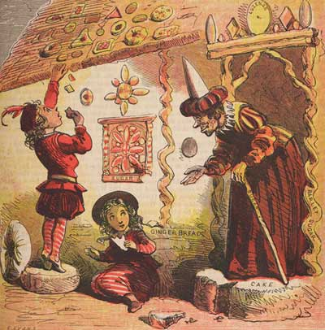
Fairy and Traditional Tales:
Not too long after the era of Shakespeare, stories that would come to be known as fairy tales started in France. Many fairy tales from this point in time were stories that were passed down from generations before, and simply needed to be put to paper.
The tales were mostly written with children in mind. They were created to teach children basic life lessons in storytelling form. The story of Hansel and Gretel was meant to scare children from wandering off in the woods. Telling a story is a tangible example of how legends and myths make storytelling that much more valuable to an audience.

Slide 5
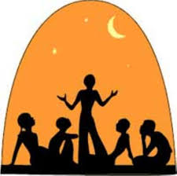
Story Telling during Story Telling Week:
What activities can you do?
Simple activities are the best.
Getting comfortable and start telling a story to your child, but also encouraging them to help decide where the story goes.
Choose characters, where they are, what they are doing there and what dilemma (problem) are they going to over come.
Nothing needs to be written down, oral story telling is the best.

Slide 6
For online stories that you can listen to please check out the hyperlink below:
Storyline

