Slide 1
Children’s Mental Health Week Assembly KS2

Slide 2
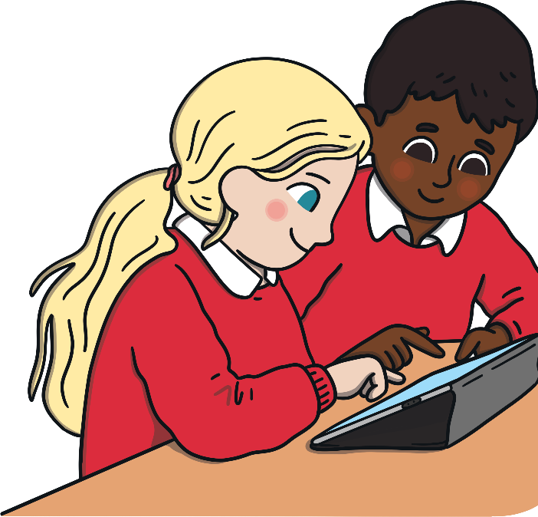
Children’s Mental Health Week
Every year, Children’s Mental Health Week takes place during February.
Mental health charities and schools get involved to help teach children all about mental health and wellbeing.
We need to look after our minds as well as our bodies. That’s why learning about and looking after our mental health is just as important as learning about and looking after our physical health.
This year, the theme for Children’s Mental Health Week is…
‘Express Yourself!’

Slide 3
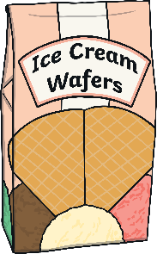
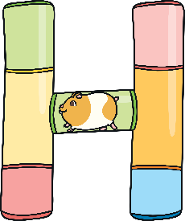
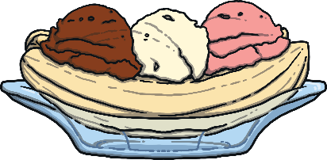
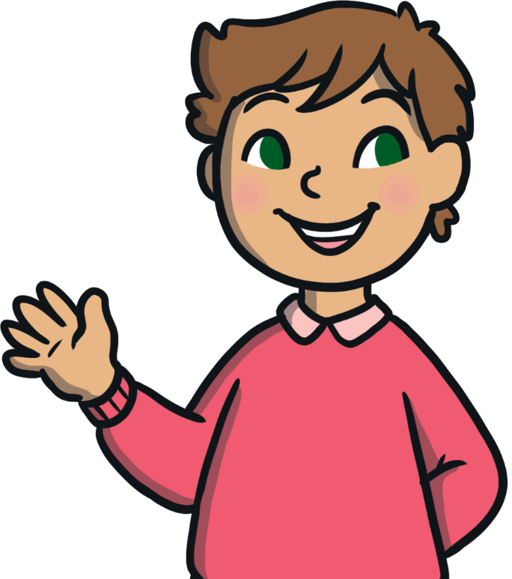
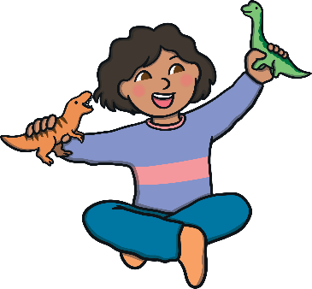
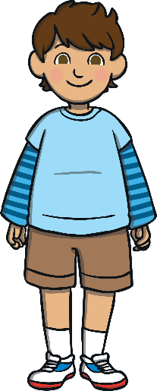
What Makes You, You?

Slide 4
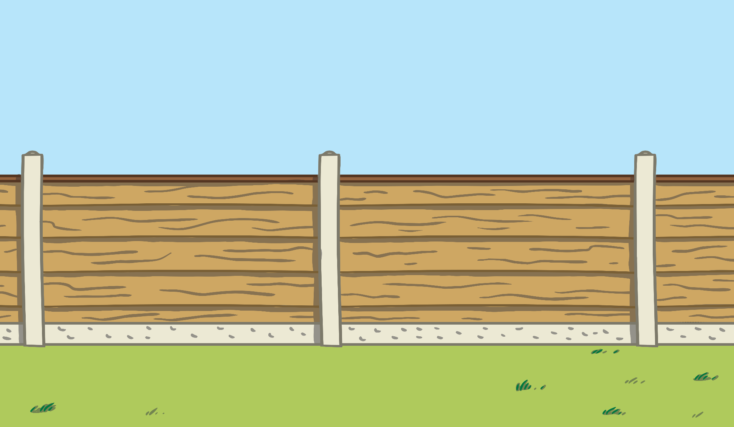
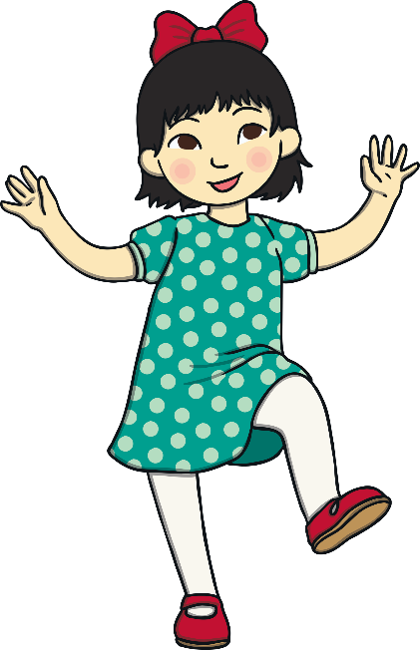
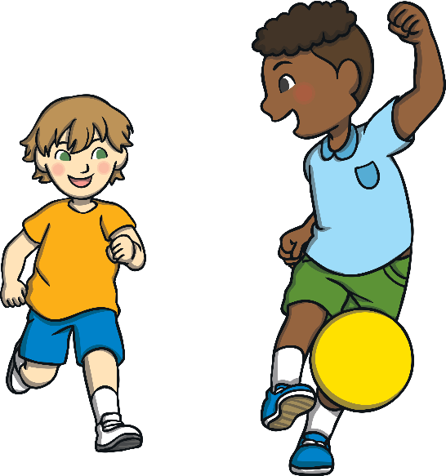
What Makes You, You?
As human beings, we are all unique.
We each have our own likes and dislikes.
We have different interests and hobbies.
We have qualities and strengths to be proud of.
All these things make you, you and me, me.

Slide 5
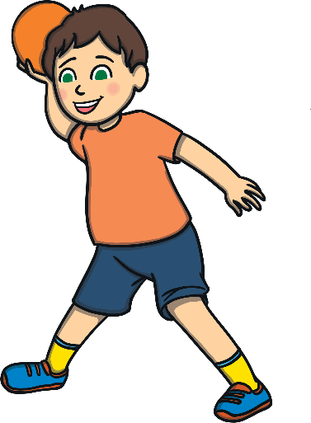
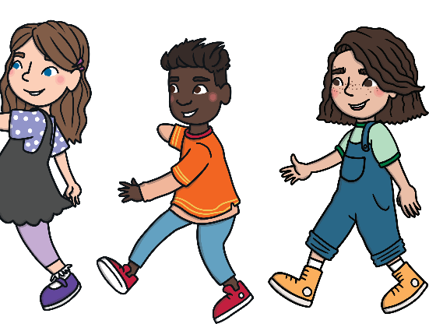
Express Yourself!
We can express who we are in lots of different ways.
Can you think of any ways in which others find out about you?
We might join a club or play a sport.
We might spend time with others who share our interests.
The way we dress might tell others about our culture or religion.

Slide 6
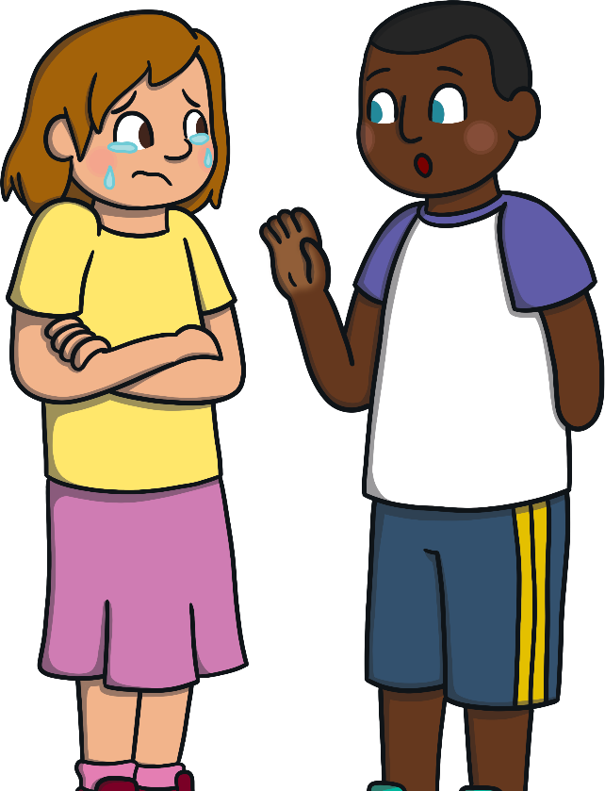
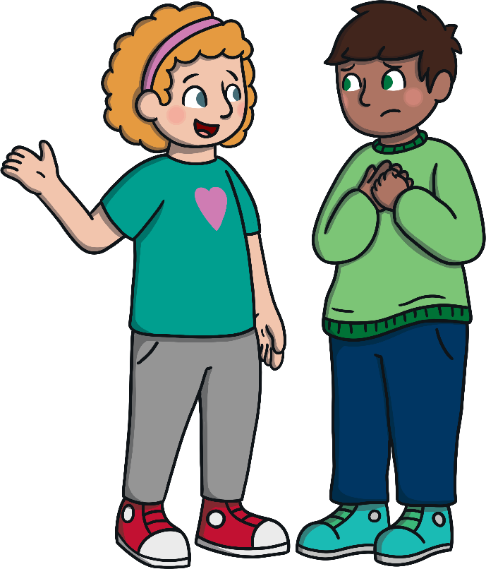
Express Yourself!
We can also express ourselves through our words and actions.
Expressing our feelings and thoughts is great for our mental health and wellbeing.
It can help us connect to others and feel less alone.
We can also get advice and support from others when we express our emotions.

Slide 7
Express Yourself!
Often, when we feel a bit low, it can really help to express ourselves in creative ways.
Let’s take a look at some examples of how people express themselves…

Slide 8
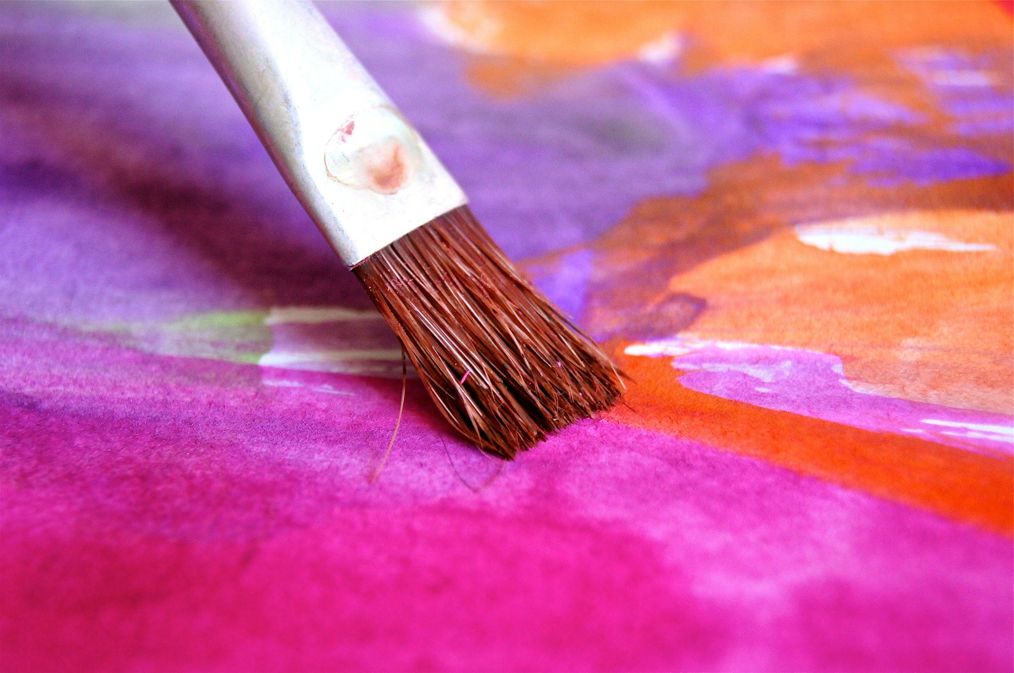
Express Yourself… Through Art

Slide 9
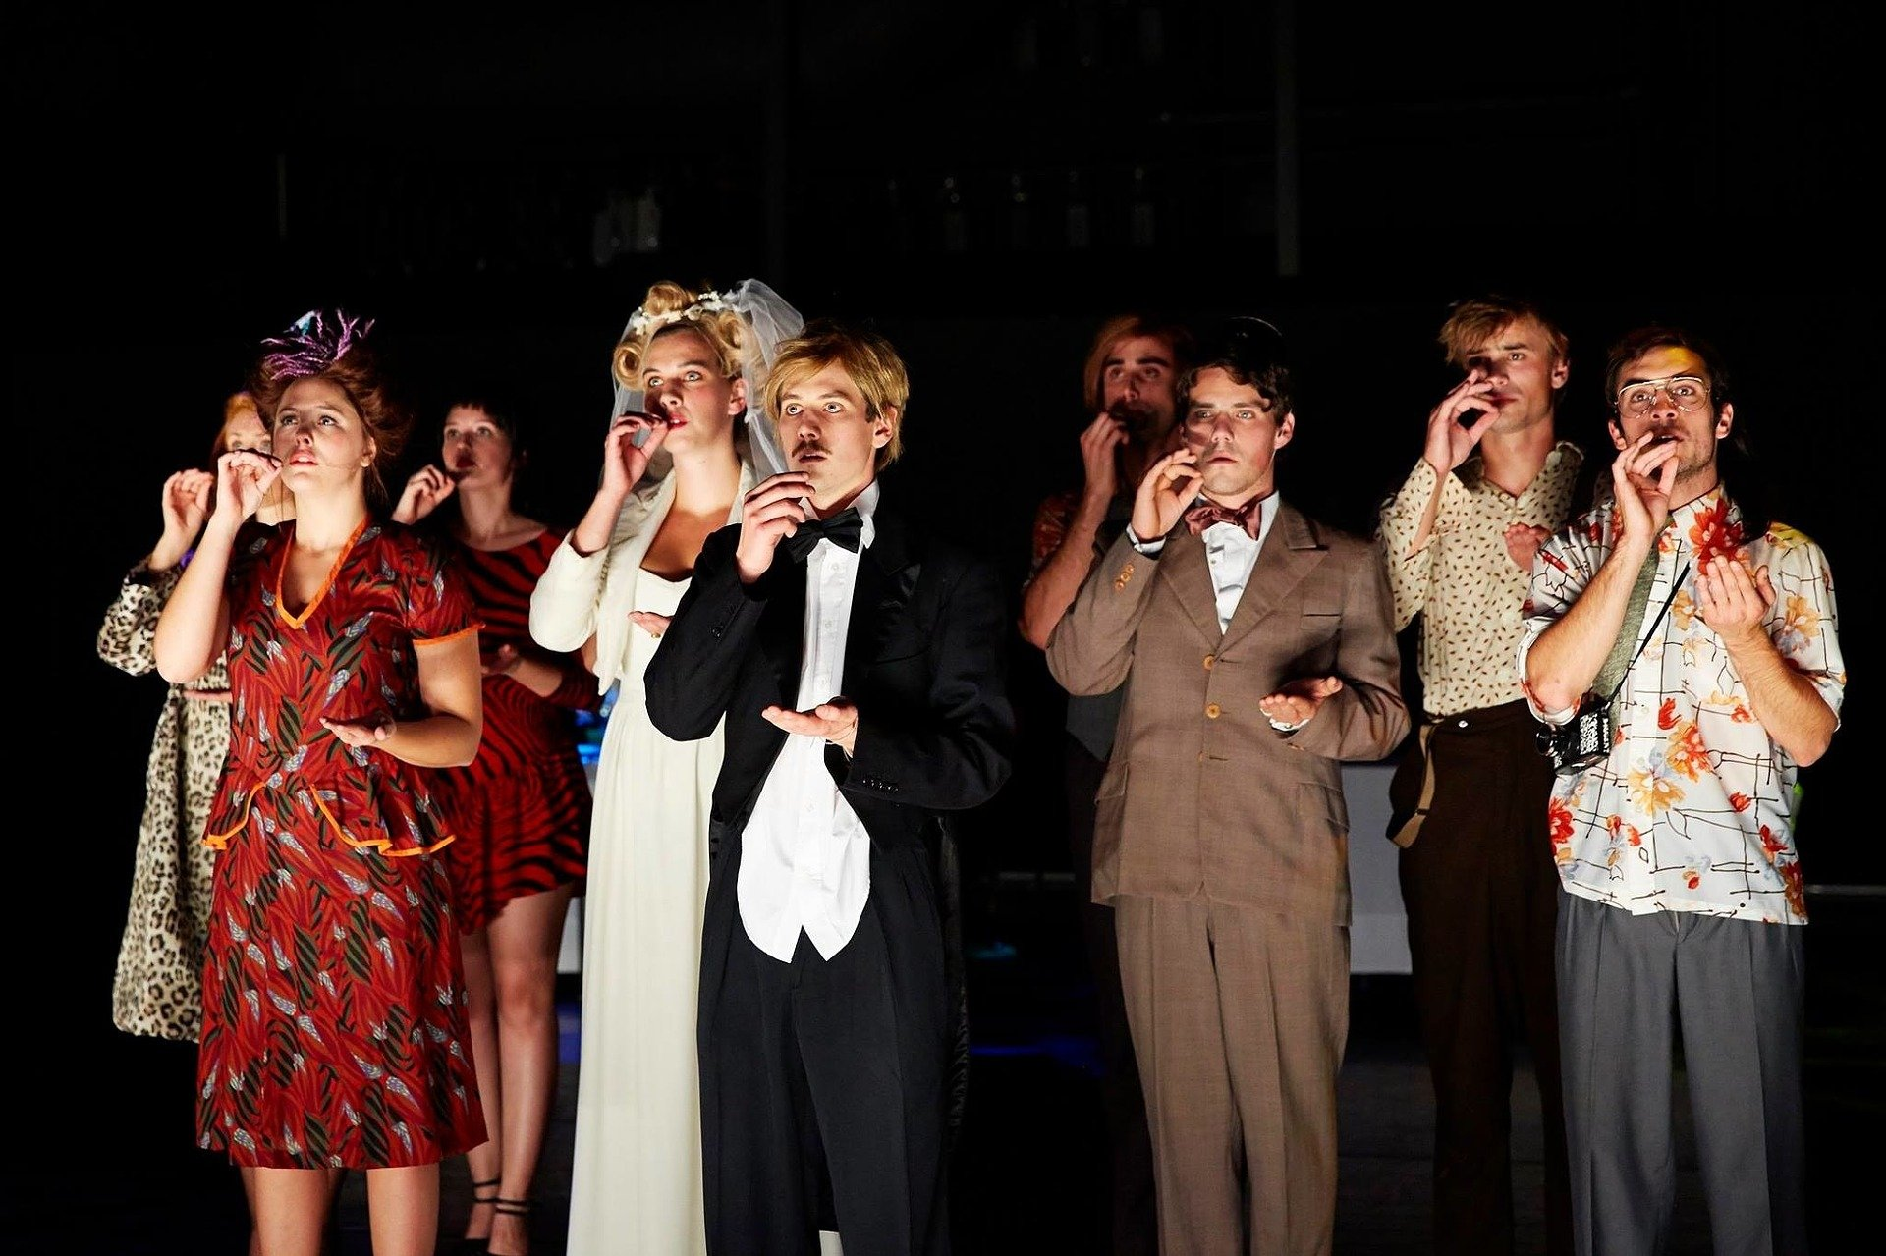
Express Yourself… Through Drama

Slide 10
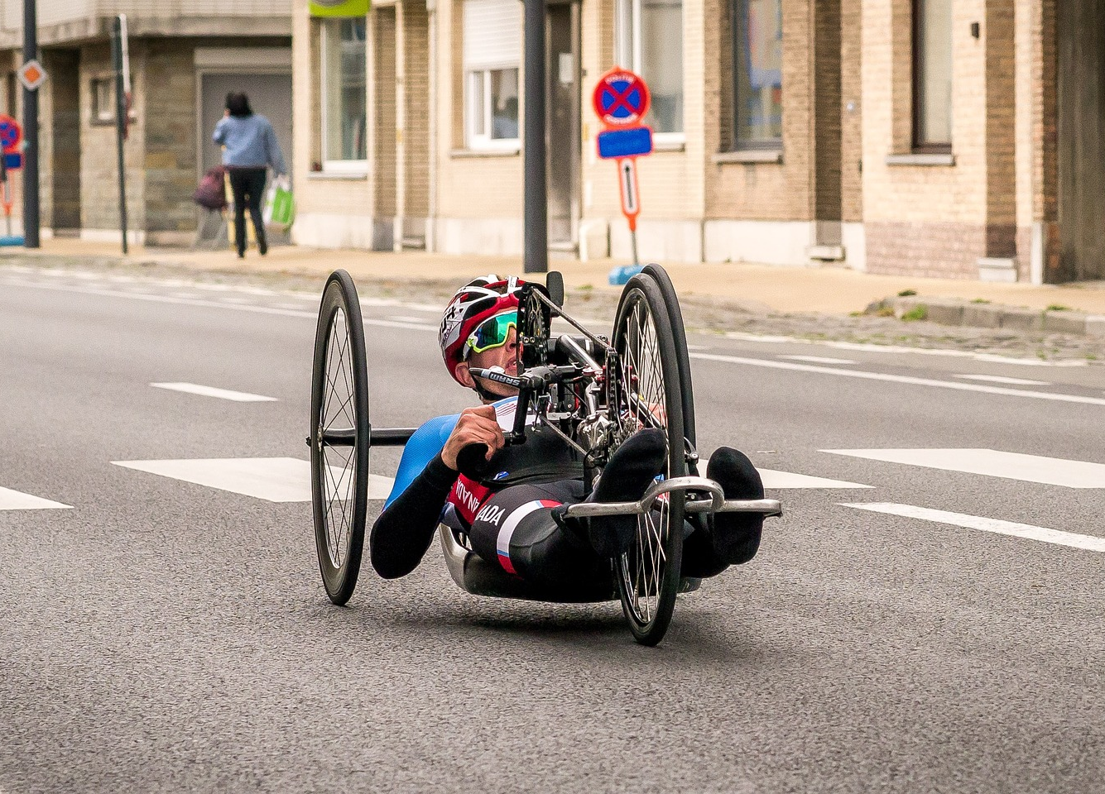
Express Yourself… Through Sport

Slide 11
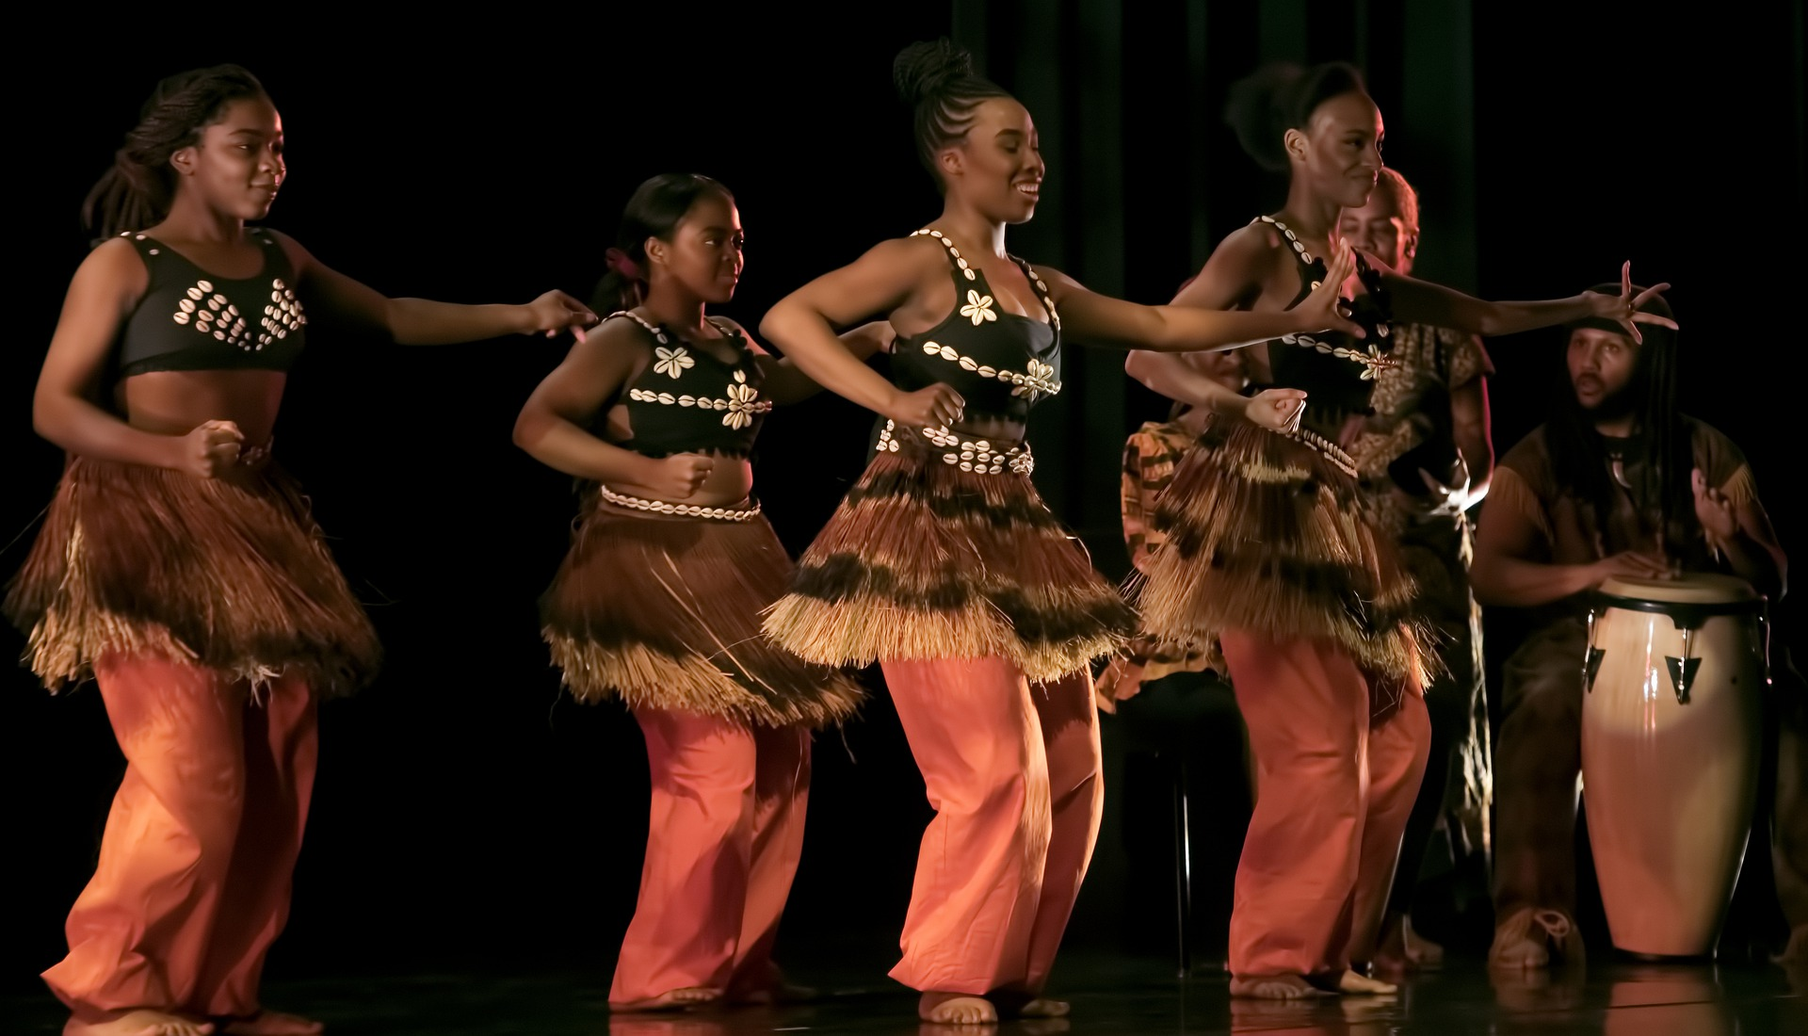
Express Yourself… Through Dance

Slide 12
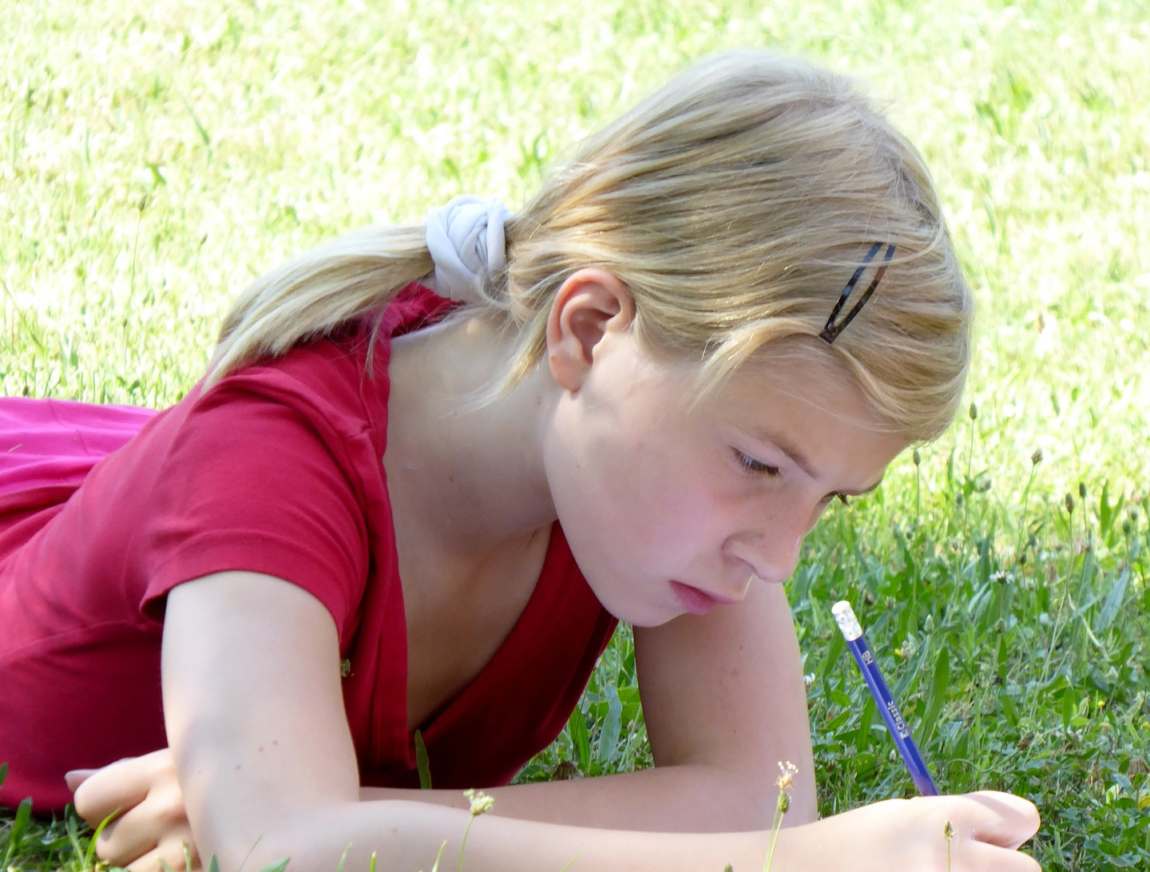
Express Yourself… Through Writing

Slide 13
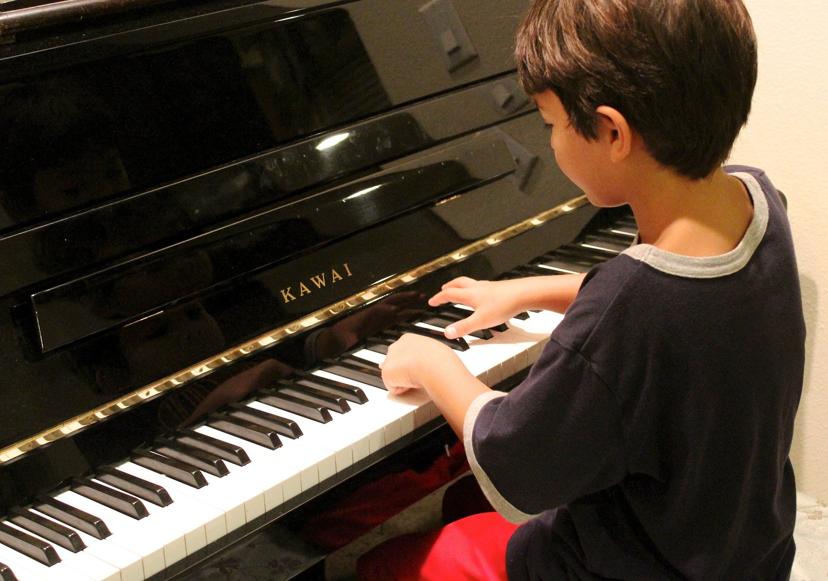
Express Yourself… Through Music

Slide 14
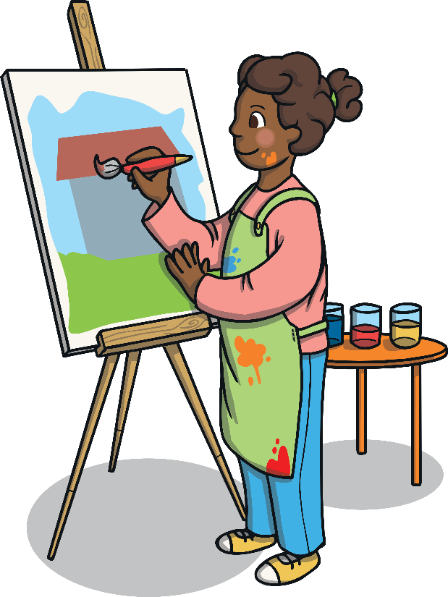
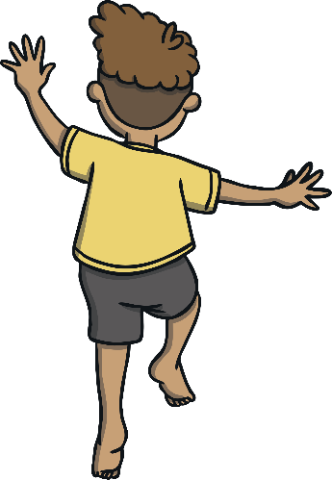
Do What Makes You Feel Good
Wow! There are so many creative ways to express ourselves.
It’s important to remember that being able to express yourself doesn’t mean being the best at something.
It doesn’t mean performing for others. It’s about doing something that makes you feel good about yourself – something you enjoy doing.

Slide 15
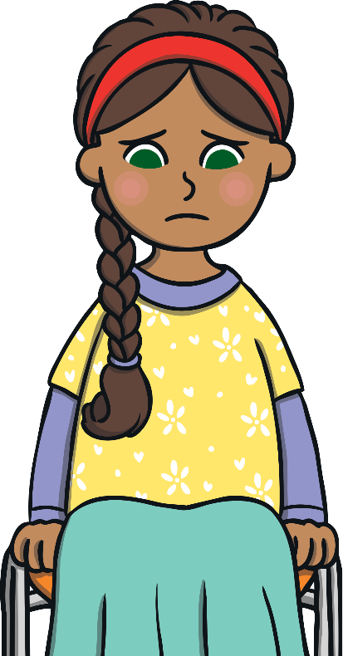
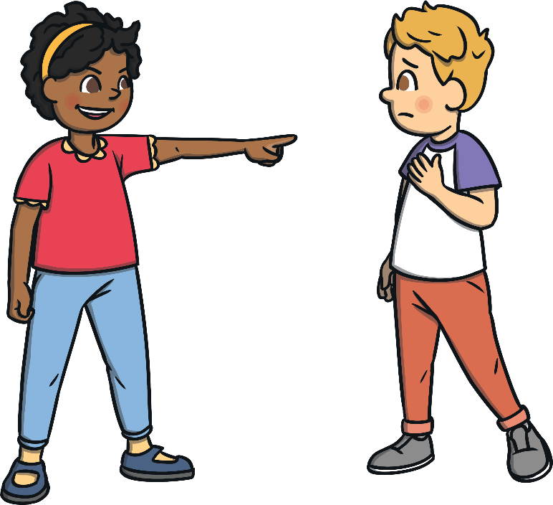
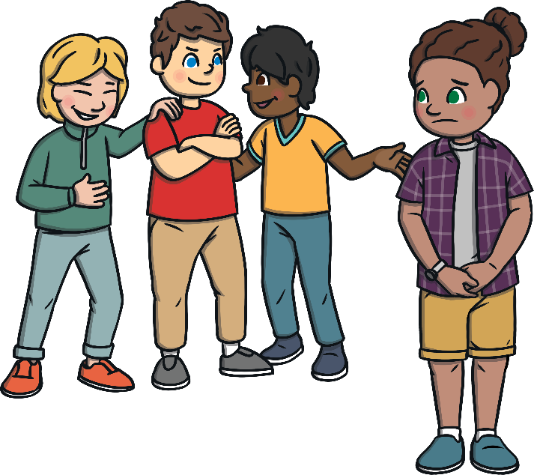
Need a Little Help?
Let’s think about why people might need to express their feelings, thoughts or ideas.
What sorts of uncomfortable feelings might people experience during these times?
What sorts of difficult things do people sometimes experience?

Slide 16
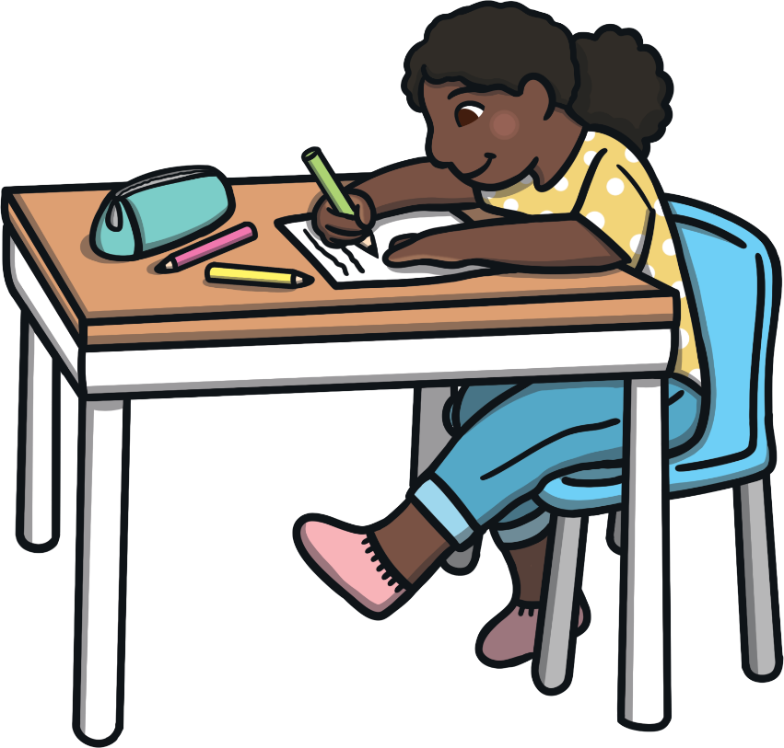
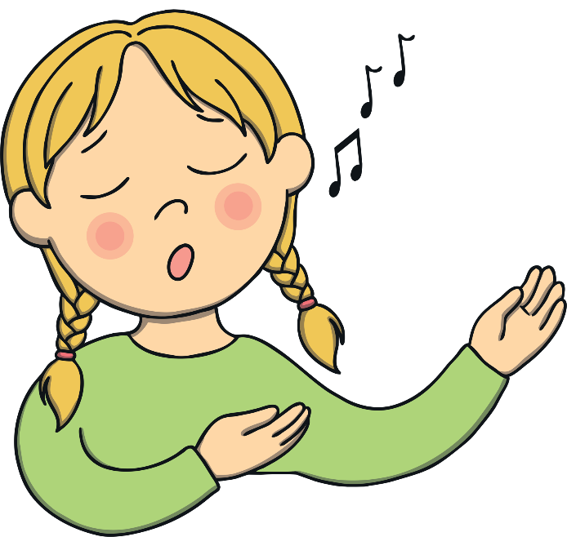
Be Yourself
It can feel good to express ourselves in whatever way feels best for us.
Think about how you currently express yourself and other ways you might like to try expressing yourself in the future.
Be yourself…
Express yourself and encourage others to do the same!

