Slide 2



Aim
To explore hopes and dreams and think about how to achieve them.

Slide 3
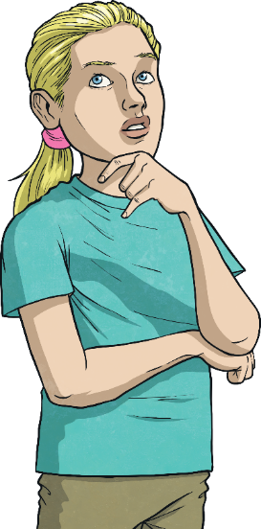

What Is Hope?
Think
Pair
Share
?
?
?

Slide 4

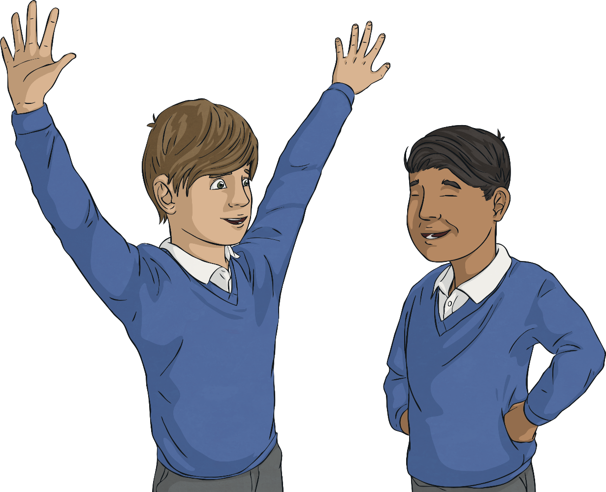
Hope is…
The feeling of wanting something good to happen and thinking that it could happen.

Slide 5
Why Is It Important to Have Hope?
Think
Pair
Share
?
?
?

Slide 6



Why Is It Important to Have Hope?
1
Hope allows us to believe that anything is possible.
2
If we didn’t have hope, we would give up when things become difficult.

Slide 7
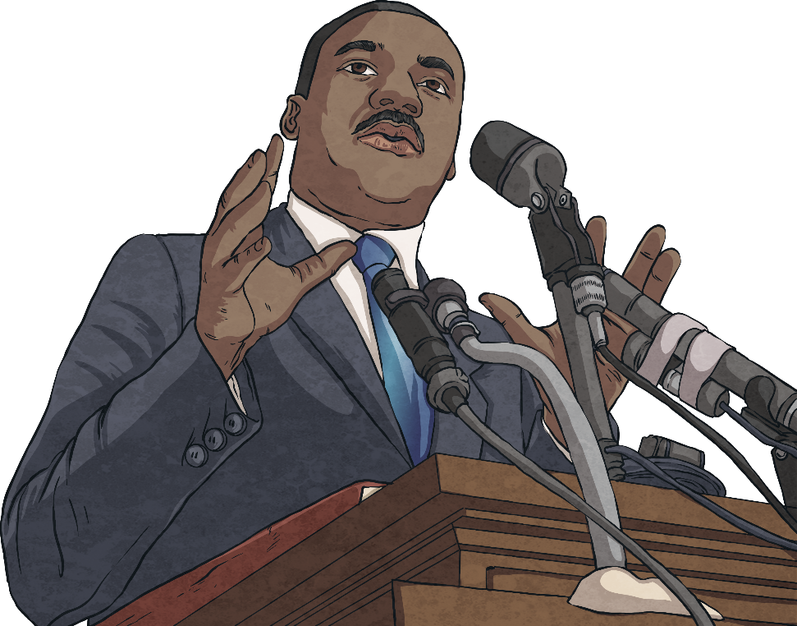
Hopes and Dreams
“I have a dream.”
This is part of a famous speech given by Martin Luther King Jr. in 1963.
His dream was that all people, regardless of race or colour, would be treated as equals.

Slide 8
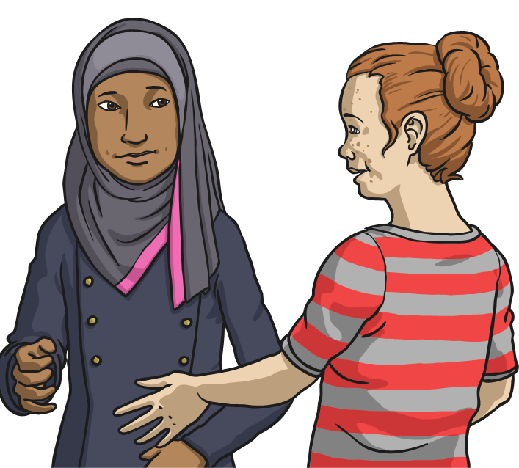
Hopes and Dreams
What are your hopes and dreams?
Perhaps you have a hope or dream for yourself or one for a wider group of people.
I hope that…
I like to think that…
I dream that one day…

Slide 9
How Will You Achieve Your Hopes and Dreams?
perseverance
hard work
practise
talent
patience
training
effort
time

Slide 10
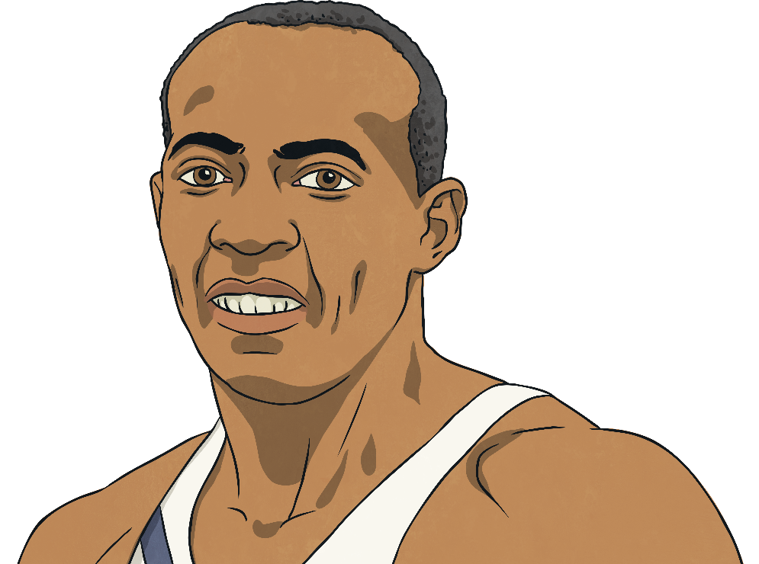
Achieving Your Hopes and Dreams
“We all have dreams. But in order to make dreams come into reality, it takes an awful lot of determination, dedication, self-discipline and effort.”
Jesse Owens, four time gold medallist in the 1936 Olympic Games.

Slide 11




Quotes
‘He who has health has hope; and he who has hope has everything.’
(Arabian proverb)
‘Once you choose hope, anything’s possible.’
(Christopher Reeve, Superman actor, paralysed in a horse-riding accident)
‘Hope is being able to see that there is light despite all of the darkness.’
(Bishop Desmond Tutu, human rights activist)
‘Hope is a waking dream.’
Aristotle

Slide 12
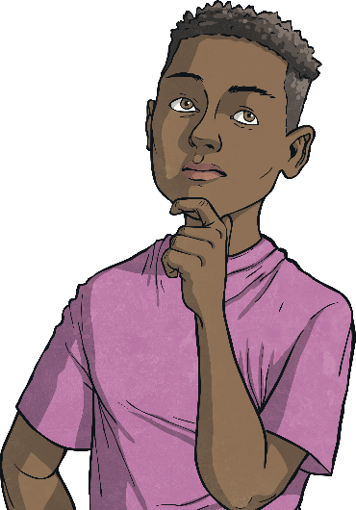
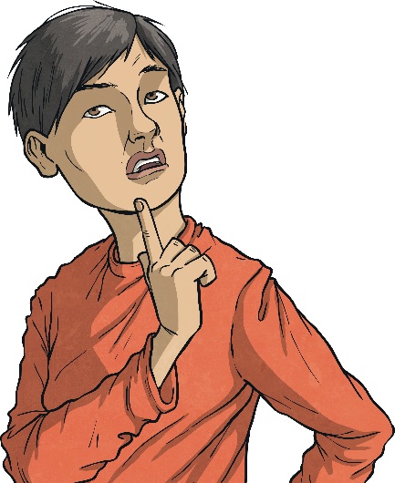
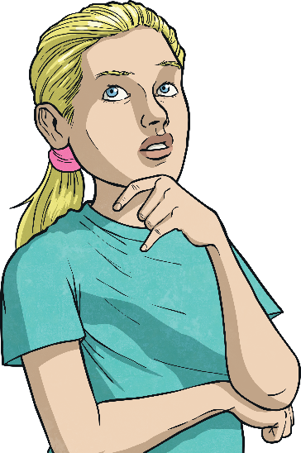
Let’s Think About Hope
Let me have the strength to work hard to fulfil my dreams.
Give me the ability to see all possibilities.
When things feel hopeless, give me hope.

